Slide 1
2021-2022 Volunteer State Book Award
Intermediate Division

Slide 2
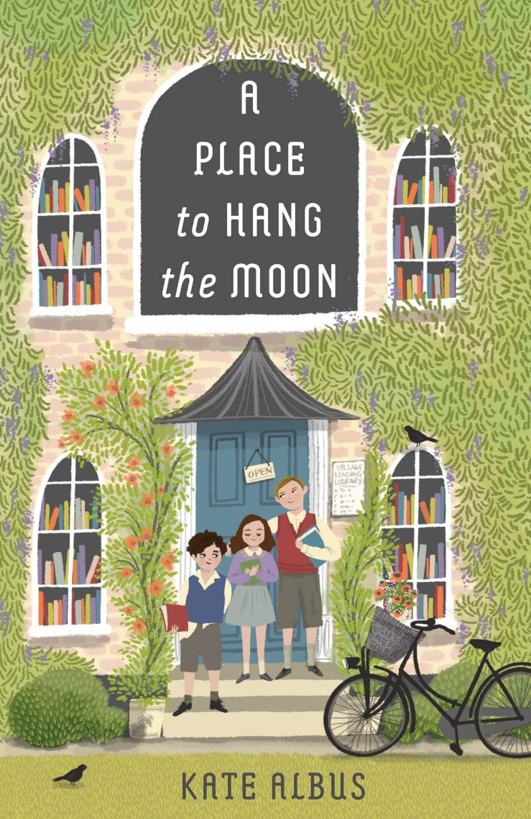
A Place to Hang the Moon by Kate Albus
Set against the backdrop of World War II, Anna, Edmund, and William are evacuated from London to live in the countryside, bouncing from home to home in search of a permanent family. Moving from one family to another, the children suffer the cruel trickery of foster brothers, the cold realities of outdoor toilets, and the hollowness of empty tummies. They seek comfort in the village lending library, whose kind librarian, Nora Muller, seems an excellent candidate--except that she has a German husband whose whereabouts are currently unknown. Nevertheless, Nora's cottage is a place where someone thinks they all three hung the moon. Which is really all you need in a mom, if you think about it. –from Goodreads

Slide 3
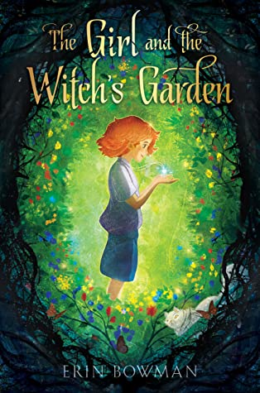
The Girl and the Witch’s Garden by Erin Bowman
Mallory Estate is the last place twelve-year-old Piper Peavey wants to spend her summer vacation. The grounds are always cold, the garden out back is dead, a mysterious group of children call the property home, and there’s a rumor that Melena M. Mallory—the owner of the estate and Piper’s wealthy grandmother—is a witch. But when Piper’s father falls ill, Mallory Estate is exactly where she finds herself. The grand house and its garden hold many secrets—some of which may even save her father—and Piper will need to believe in herself, her new friends, and magic if she wants to unlock them before it’s too late. –from Goodreads

Slide 4
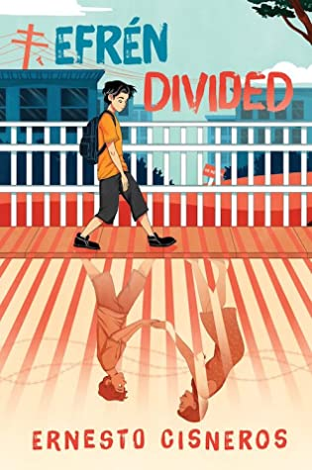
Efren Divided by Ernesto Cisneros
Efrén Nava’s Amá is his Superwoman - or Soperwoman, named after the delicious Mexican sopes his mother often prepares. Both Amá and Apá work hard all day to provide for the family, making sure Efrén and his younger siblings Max and Mía feel safe and loved. But Efrén worries about his parents; although he’s American-born, his parents are undocumented. His worst nightmare comes true one day when Amá doesn’t return from work and is deported across the border to Tijuana, México. Now more than ever, Efrén must channel his inner Soperboy to help take care of and try to reunite his family. –from Goodreads

Slide 5
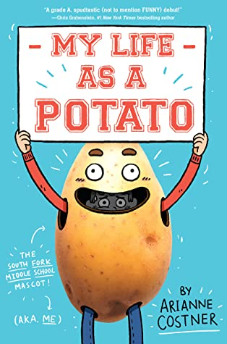
My Life as a Potato
by Arianne Costner
Ben Hardy believes he's cursed by potatoes. And now he's moved to Idaho, where the school's mascot is Steve the Spud! Yeah, this cannot be good. After accidentally causing the mascot to sprain an ankle, Ben is sentenced to Spud duty for the final basketball games of the year. But if the other kids know he's the Spud, his plans for popularity are likely to be a big dud! Ben doesn't want to let the team down, so he lies to his friends to keep it a secret. No one will know it's him under the potato suit . . . right?. –from Goodreads

Slide 6
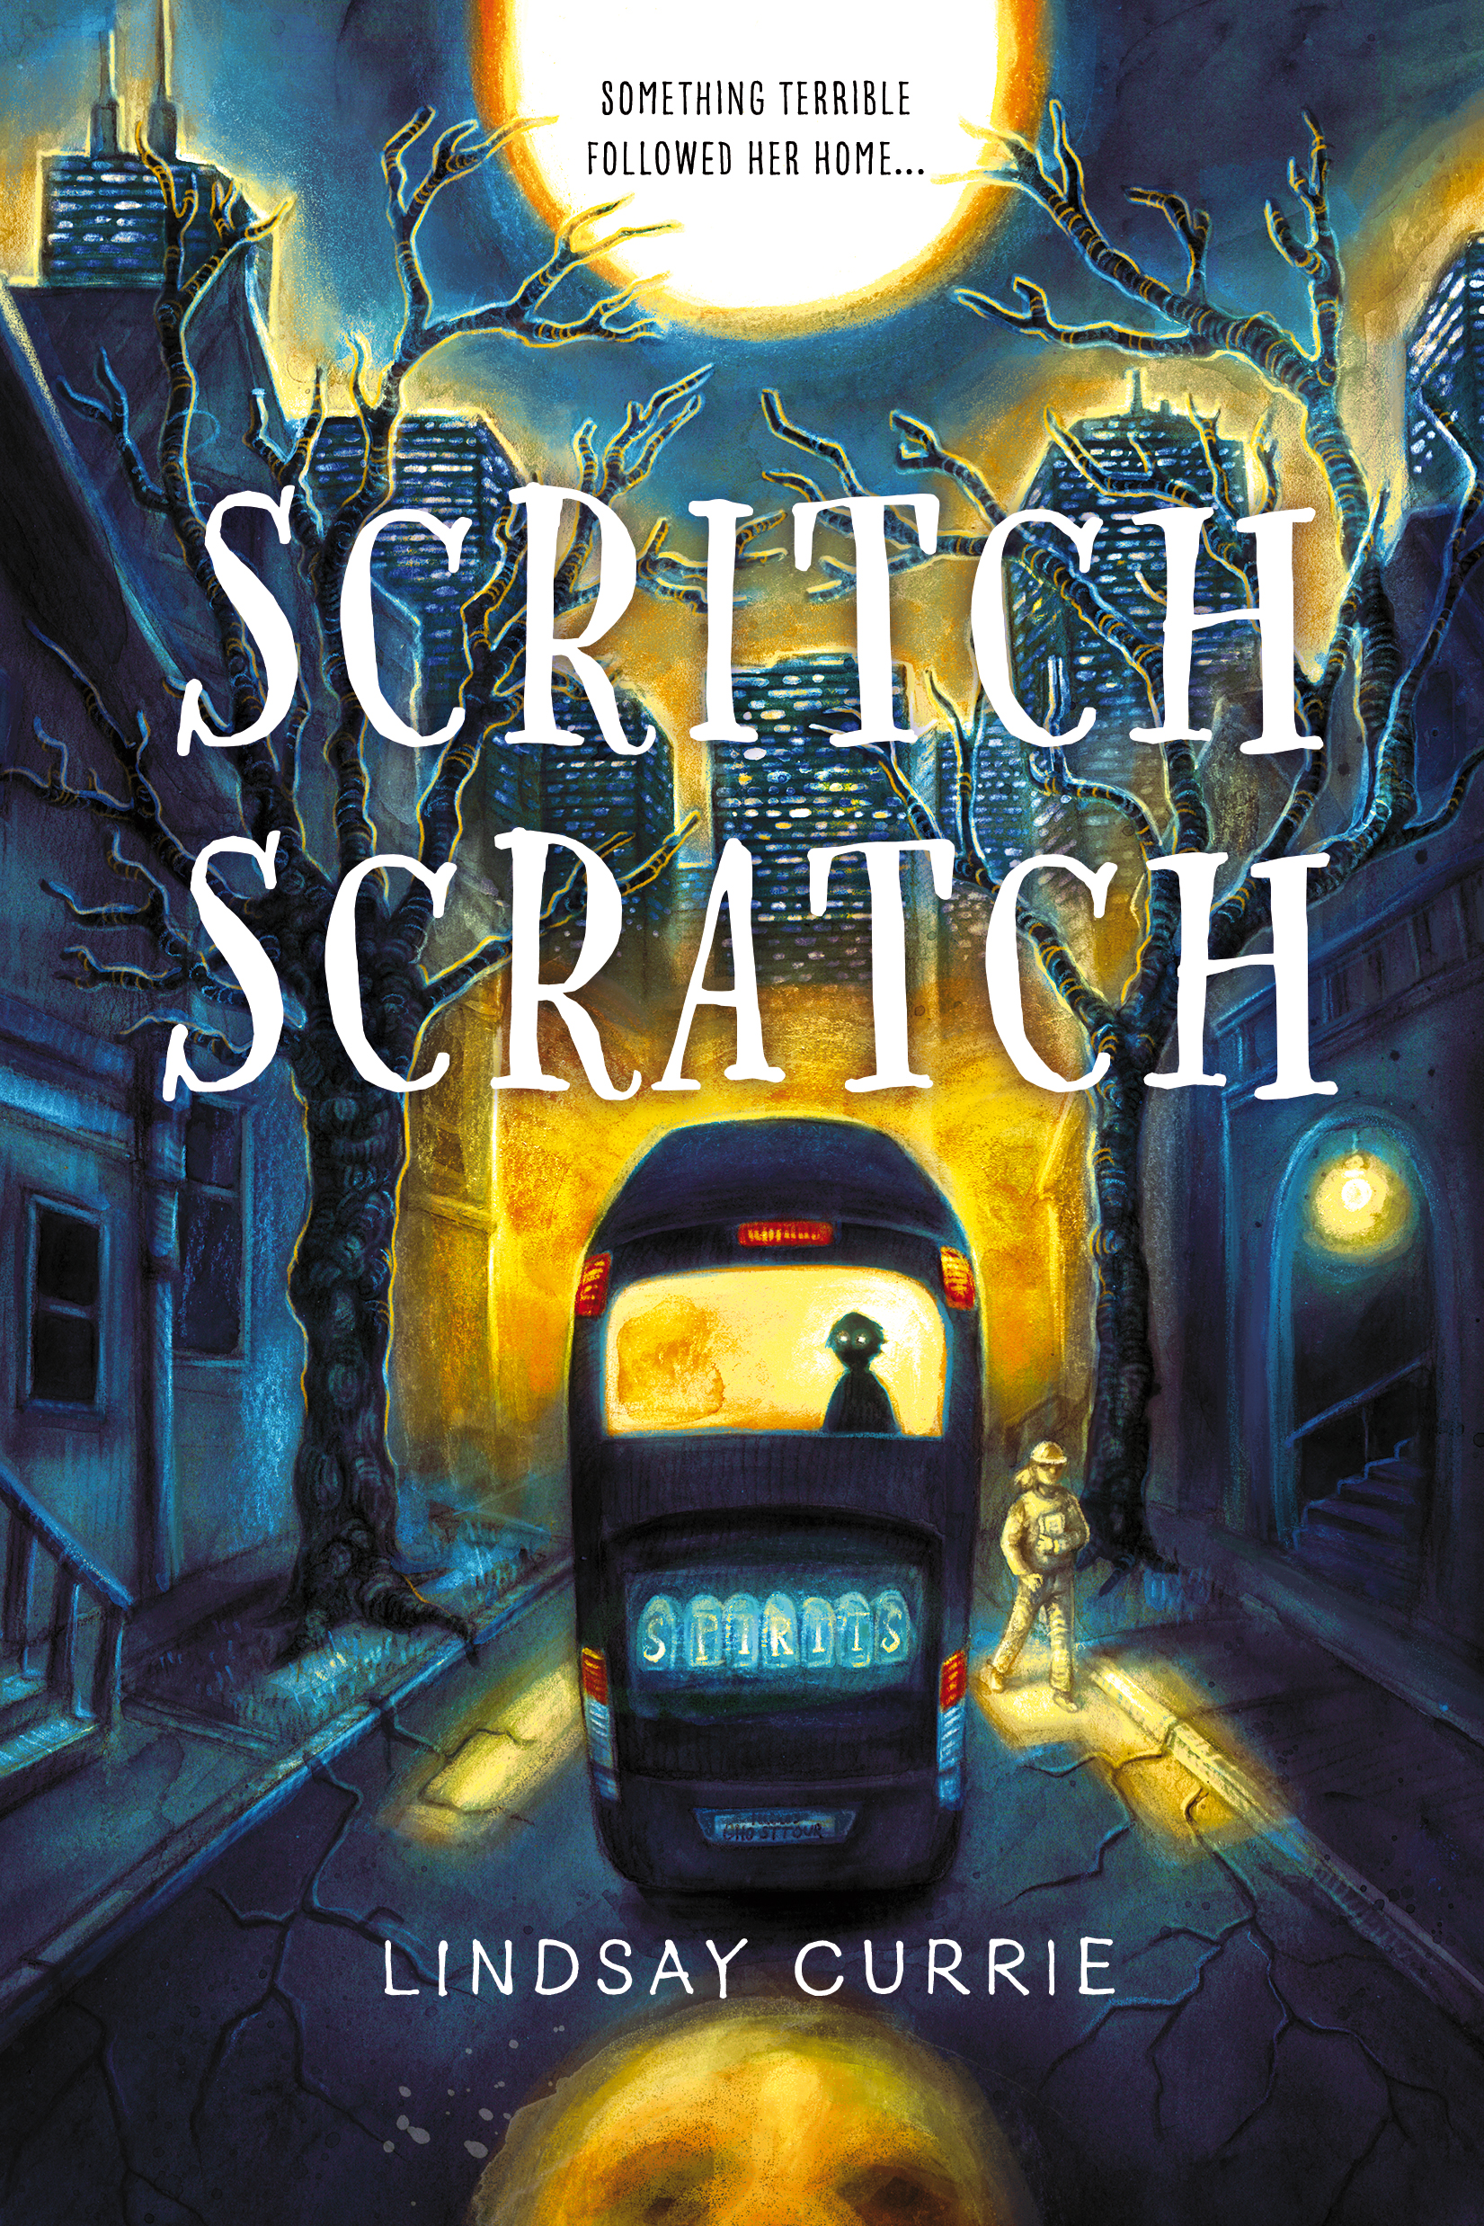
Scritch Scratch
by Lindsay Currie
Claire has absolutely no interest in the paranormal. She’s a scientist, which is why she can’t think of anything worse than helping out her dad on one of his ghost-themed Chicago bus tours. She thinks she’s made it through when she sees a boy with a sad face and dark eyes at the back of the bus. There’s something off about his presence, especially because when she checks at the end of the tour…he’s gone. Claire tries to brush it off, she must be imagining things, letting her dad’s ghost stories get the best of her. But then the scratching starts. Voices whisper to her in the dark. The number 396 appears everywhere she turns. And the boy with the dark eyes starts following her. Claire is being haunted. The boy from the bus wants something...and Claire needs to find out what before it’s too late. –from Goodreads

Slide 7
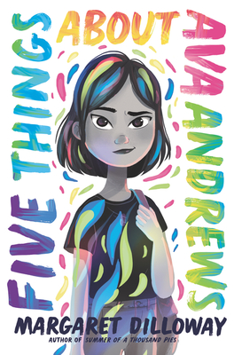
Five Things About Ava Andrews
by Margaret Dilloway
On the inside, 11-year-old Ava Andrews bubbles with ideas and plans. On the outside, everyone except her best friend, Zelia, thinks she doesn’t talk or, worse, is stuck-up. What nobody knows is that Ava has invisible disabilities: anxiety and a heart condition. Ava hopes middle school will be a fresh start, but when Zelia moves across the country and Ava’s Nana Linda pushes her to speak up about social issues, she withdraws further. So Ava is shocked when her writing abilities impress her classmates and they invite her to join their improv group, making up stories onstage. Determined to prove she can control her anxiety, she joins—and discovers a whole new side of herself, and what it means to be on a team. But as Ava’s self-confidence blossoms, her relationship with Zelia strains, and she learns that it isn’t enough just to raise your voice—it’s how and why you use it that matters. –from Goodreads

Slide 8
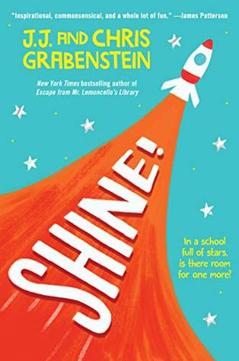
Shine!
by J.J. and Chris Grabenstein
Who do you want to be? asks Mr. Van Deusen. And not when you grow up. Right here, right now. Shine on! might be the catchphrase of twelve-year-old Piper's hero--astronaut, astronomer, and television host Nellie Dumont Frisse--but Piper knows the truth: some people are born to shine, and she's just not one of them. That fact has never been clearer than now, since her dad's new job has landed them both at Chumley Prep, a posh private school where everyone seems to be the best at something and where Piper definitely doesn't fit in.–from Goodreads

Slide 9
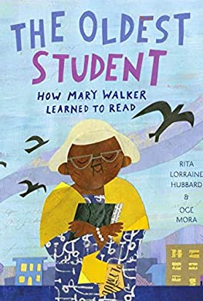
The Oldest Student: How Mary Walker Learned to Read by Rita Lorraine Hubbard, ill. by Oge Mora
In 1848, Mary Walker was born into slavery. At age 15, she was freed, and by age 20, she was married and had her first child. By age 68, she had worked numerous jobs, including cooking, cleaning, babysitting, and selling sandwiches to raise money for her church. At 114, she was the last remaining member of her family. And at 116, she learned to read. From Rita Lorraine Hubbard and Oge Mora comes the inspirational story of Mary Walker, a woman whose long life spanned from the Civil War to the Civil Rights Movement, and who--with perseverance and dedication--proved that you're never too old to learn. –from Goodreads

Slide 10
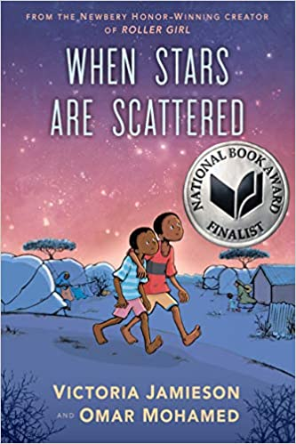
When Stars are Scattered by Victoria Jamieson and Omar Mohamed
Omar and his younger brother, Hassan, have spent most of their lives in Dadaab, a refugee camp in Kenya. Life is hard there: never enough food, achingly dull, and without access to the medical care Omar knows his nonverbal brother needs. So when Omar has the opportunity to go to school, he knows it might be a chance to change their future, but it would also mean leaving his brother, every day. Heartbreak, hope, and humor exist together in this graphic novel about the day-to-day life of a refugee, as told to New York Times Bestselling author/artist Victoria Jamieson by Omar Mohamed, the Somali man who lived the story. –from Amazon.com

Slide 11
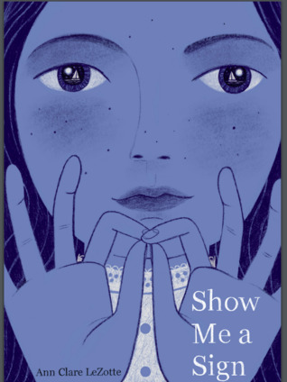
Show Me a Sign
by Ann Clare LeZotte
Mary Lambert has always felt safe and protected on her beloved island of Martha's Vineyard. Her great-grandfather was an early English settler and the first deaf islander. Now, over a hundred years later, many people there - including Mary - are deaf, and nearly everyone can communicate in sign language. Mary has never felt isolated. But recent events have delivered winds of change. Mary's brother died, leaving her family shattered. Tensions over land disputes are mounting between English settlers and the Wampanoag people. And a cunning young scientist has arrived, hoping to discover the origin of the island's prevalent deafness. His maniacal drive to find answers soon renders Mary a "live specimen" in a cruel experiment. Her struggle to save herself is at the core of this novel.–from Goodreads

Slide 12
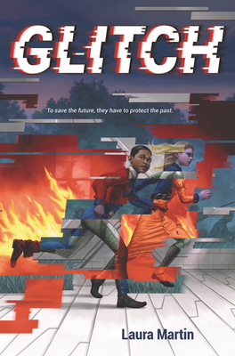
Glitch
by Laura Martin
Regan Fitz and Elliot Mason have been enemies since they started training to become Glitchers—people who travel through time to preserve important historical events. But everything changes when they find a letter from Regan’s future self, warning them about an impending disaster that threatens them and everyone they know. Will they be able to set aside their past in order to save the future? –from Goodreads

Slide 13
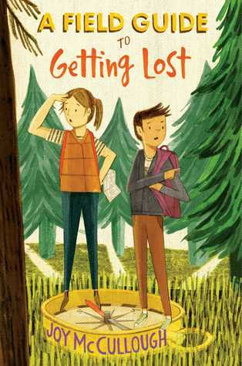
A Field Guide to Getting Lost by Joy McCullough
A girl with a passion for science and a boy who dreams of writing fantasy novels must figure out how to get along now that their parents are dating in this lively, endearing novel.
Sutton and Luis couldn’t be more different from each other. Except now that their parents are dating, these two have to find some common ground. Will they be able to navigate their way down a path they never planned on exploring? –from Goodreads

Slide 14
Prairie Lotus by Linda Sue Park
A book about a girl determined to fit in and realize her dreams: getting an education, becoming a dressmaker in her father's shop, and making at least one friend. Hanna, a half-Asian girl in a small town in America's heartland, lives in 1880. Hanna's adjustment to her new surroundings, and the townspeople's prejudice against Asians, is at the heart of the story. –from Goodreads

Slide 15
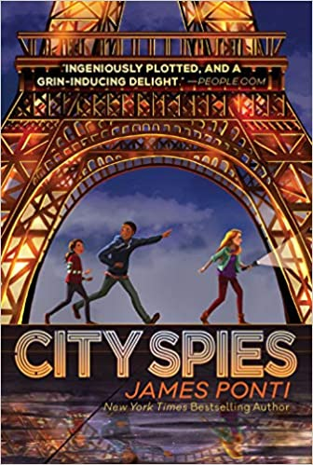
City Spies by James Ponti
In this thrilling new series, five kids from all over the world are brought together and transformed them into real-life spies.
Operating out of a base in Scotland, the City Spies are five kids from various parts of the world. When they’re not attending the local boarding school, they’re honing their unique skills, such as sleight of hand, breaking and entering, observation, and explosives. All of these allow them to go places in the world of espionage where adults can’t. Told from the POV of hacker extraordinaire, Sara Martinez, these newbie spies are heading to Paris for an international youth summit, hacking into a rival school’s computer to prevent them from winning a million euros, dangling thirty feet off the side of a building, and trying to stop a villain…all while navigating the complex dynamics of their new team. No one said saving the world was easy! –from Amazon.com

Slide 16
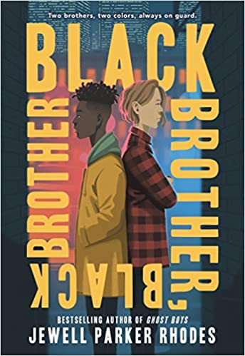
Black Brother, Black Brother by Jewell Parker Rhodes
A powerful coming-of-age story about two brothers, one who presents as white, the other as black, and the complex ways in which they are forced to navigate the world, all while training for a fencing competition.
Powerful and emotionally gripping, Black Brother, Black Brother is a careful examination of the school-to-prison pipeline and follows one boy's fight against racism and his empowering path to finding his voice.
--from Amazon.com

Slide 17
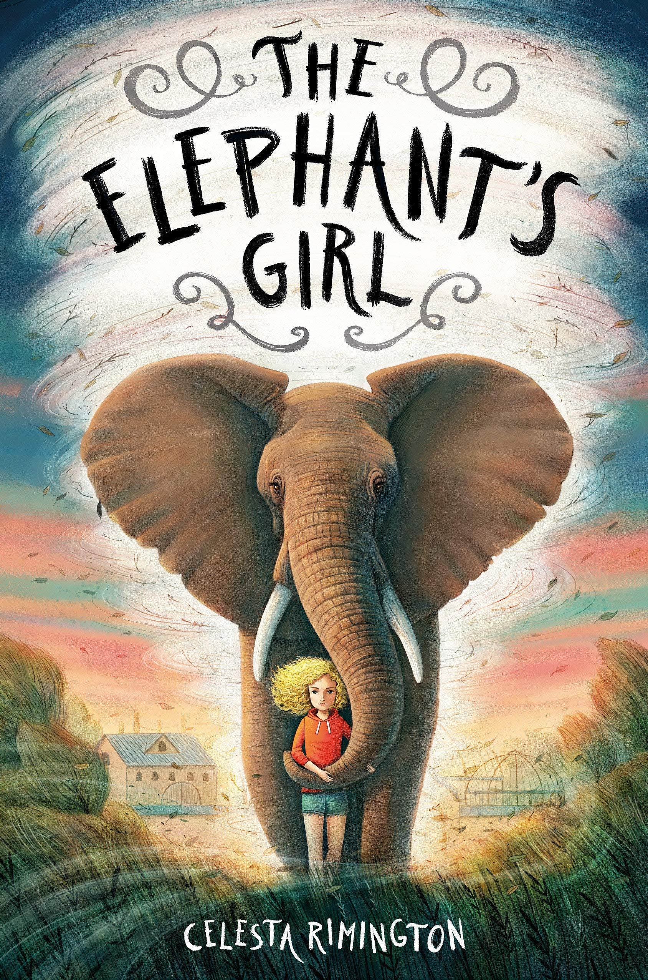
The Elephant’s Girl by Celesta Rimington
Lexington Willow can't remember her past. When she was a toddler, a tornado swept her away from everyone and everything she knew and landed her near an enclosure in a Nebraska zoo, where an elephant named Nyah protected her from the storm. With no trace of her family, Lex grew up at the zoo with her foster father, Roger; her best friend, Fisher; and the wind whispering in her ear. Now that she's twelve, Lex is finally old enough to help with the elephants. But during their first training session, Nyah sends her a telepathic image of the woods outside the zoo. Despite the wind's protests, Lex decides to investigate Nyah's message and gets wrapped up in an adventure involving ghosts, lost treasure, and a puzzle that might be the key to finding her family. Can Lex summon the courage to hunt for who she really is--and why the tornado brought her here all those years ago? –from Goodreads

Slide 18
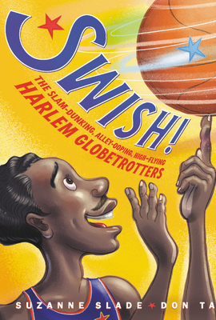
Swish! The Slam-Dunking, Alley-Ooping, High-Flying Harlem Globetrotters by Suzanne Slade
In this book you will find one-finger ball-spinning, rapid-fire mini-dribbling, and a ricochet head shot! You will find skilled athletes, expert players, and electrifying performers -- all rolled into one! You will find nonstop, give-it-all-you've-got, out-to-win-it, sky's-the-limit BASKETBALL! You will find The Harlem Globetrotters , who played the most groundbreaking, breathtaking ball the world had ever seen. With rhythmic writing and dynamic illustrations, Swish! is a celebration of the greatness, goodness, and grit of this remarkable team.. –from Goodreads

Slide 19
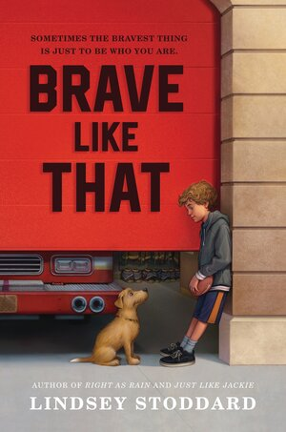
Brave Like That by Lindsey Stoddard
Cyrus Olson’s dad is a hero—Northfield’s former football star and now one of their finest firefighters. Everyone expects Cyrus to follow in his dad’s record-breaking footsteps, and he wishes they were right—except he’s never been brave like that. But this year, with the help of a stray dog, a few new friends, a little bit of rhythm, and a lot of nerve, he may just discover that actually…he is. --from Goodreads

Slide 20
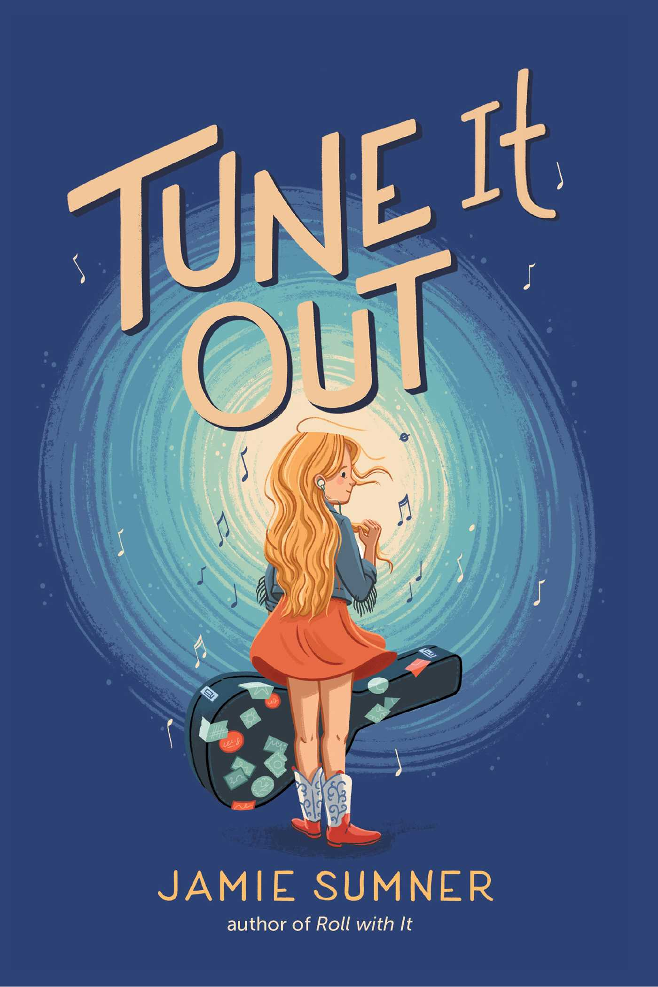
Tune It Out by Jamie Sumner
Lou Montgomery has the voice of an angel, or so her mother tells her and anyone else who will listen. But Lou can only hear the fear in her own voice. She’s never liked crowds or loud noises or even high fives; in fact, she’s terrified of them, which makes her pretty sure there’s something wrong with her. When Lou crashes their pickup on a dark and snowy road, child services separate the mother-daughter duo. Now she has to start all over again at a fancy private school far away from anything she’s ever known. With help from an outgoing new friend, her aunt and uncle, and the school counselor, she begins to see things differently. A sensory processing disorder isn’t something to be ashamed of, and music might just be the thing that saves Lou—and maybe her mom, too.. –from Goodreads

Slide 21
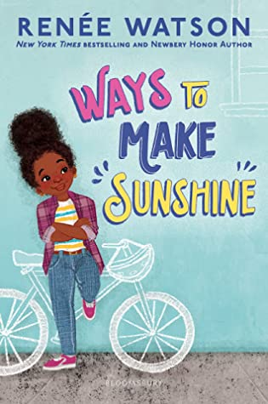
Ways to Make Sunshine by Renee Watson
Ryan Hart loves to spend time with her friends, loves to invent recipes, and has a lot on her mind—school, self-image, and family. Her dad finally has a new job, but money is tight. That means changes like selling their second car and moving into a new (old) house. But Ryan is a girl who knows how to make sunshine out of setbacks. Because Ryan is all about trying to see the best. Even when things aren’t all she would wish for—her brother is infuriating, her parents don’t understand, when her recipes don’t turn out right, and when the unexpected occurs—she can find a way forward, with wit and plenty of sunshine. –from Goodreads

