Slide 1
2021-2022 Volunteer State Book Award
Primary Division

Slide 2
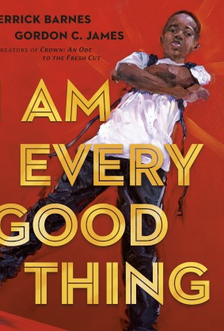
I Am Every Good Thing by Derrick Barnes; ill. by Gordon C. James
The confident Black narrator of this book is proud of everything that makes him who he is. He's got big plans, and no doubt he'll see them through--as he's creative, adventurous, smart, funny, and a good friend. Sometimes he falls, but he always gets back up. And other times he's afraid, because he's so often misunderstood and called what he is not. So slow down and really look and listen, when somebody tells you--and shows you--who they are. There are superheroes in our midst! –from Goodreads

Slide 3
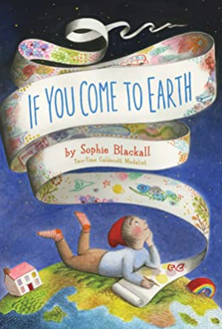
If You Come to Earth by Sophie Blackall
If You Come to Earth is a glorious guide to our home planet, and a call for us to take care of both Earth and each other. Inspired by the thousands of children Sophie Blackall has met during her travels around the world in support of UNICEF and Save the Children, this funny and touching story about a curious and imaginative child carries the important message about the need to care for the earth and each other. –from Goodreads

Slide 4
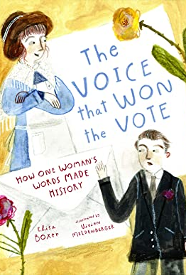
The Voice that Won the Vote: How One Woman’s Words Made History by Elisa Boxer, ill. by Vivien Mildenberger
In August of 1920, women's suffrage in America came down to the Tennessee legislature approving ratification of the 19th amendment, giving all American women the right to vote. The historic moment came down to a single vote and the voter who tipped the scale toward equality did so because of a powerful letter his mother, Febb Burn, had written him urging him to "Vote for suffrage and don't forget to be a good boy." The Voice That Won the Vote is the story of Febb, her son Harry, and the letter than gave all American women a voice. –from Goodreads

Slide 5
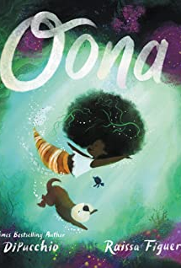
Oona by Kelly DiPucchio, illust. by Raissa Figueroa
Meet Oona. The big sea’s littlest mischief maker. She and her best friend, Otto, love to search for treasure, but often find trouble instead. Messy, tricky, sometimes shark-related, trouble, but that’s never stopped them before! After all, no proper treasure hunt is without some adventure. But when the grandest treasure yet is stuck in a deep, dark rift, Oona’s not sure if she can dive right in. What might be waiting for her in those unknown waters? –from Goodreads

Slide 6
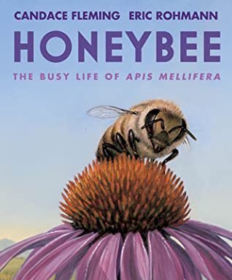
Honeybee: The Busy Life of Apis Mellifera by Candace Fleming, ill. by Eric Rohmann
Get up close and personal with Apis, one honeybee, as she embarks on her journey through life. Candace Fleming and Eric Rohmann describe the life cycle of the hard-working honeybee in this poetically written, thoroughly researched picture book, complete with stunning gatefold and an essay on the plight of honeybees. –from Goodreads

Slide 7
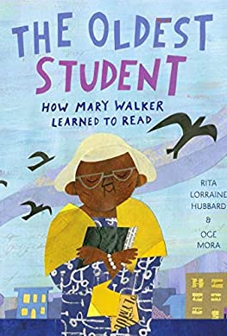
The Oldest Student: How Mary Walker Learned to Read by Rita Lorraine Hubbard, ill. by Oge Mora
In 1848, Mary Walker was born into slavery. At age 15, she was freed, and by age 20, she was married and had her first child. By age 68, she had worked numerous jobs, including cooking, cleaning, babysitting, and selling sandwiches to raise money for her church. At 114, she was the last remaining member of her family. And at 116, she learned to read. From Rita Lorraine Hubbard and Oge Mora comes the inspirational story of Mary Walker, a woman whose long life spanned from the Civil War to the Civil Rights Movement, and who--with perseverance and dedication--proved that you're never too old to learn. –from Goodreads

Slide 8
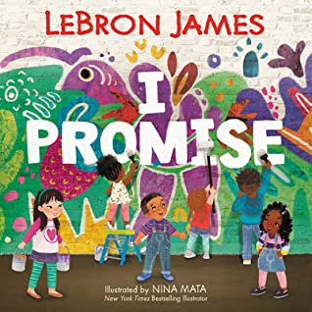
I Promise by LeBron James, ill. by Nina Mata
I Promise is a lively and inspiring picture book that reminds us that tomorrow’s success starts with the promises we make to ourselves and our community today. Featuring James’s upbeat, rhyming text and vibrant illustrations perfectly crafted for a diverse audience by New York Times bestselling artist Nina Mata, this book has the power to inspire all children and families to be their best. –from Goodreads

Slide 9
The Couch Potato by Jory John, ill. by Pete Oswald
The Couch Potato has everything he needs within reach of his sunken couch cushion. But when the electricity goes out, Couch Potato is forced to peel himself away from the comforts of his living room and venture outside. And when he does, he realizes fresh air and sunshine could be just the things he needs. –from Goodreads

Slide 10
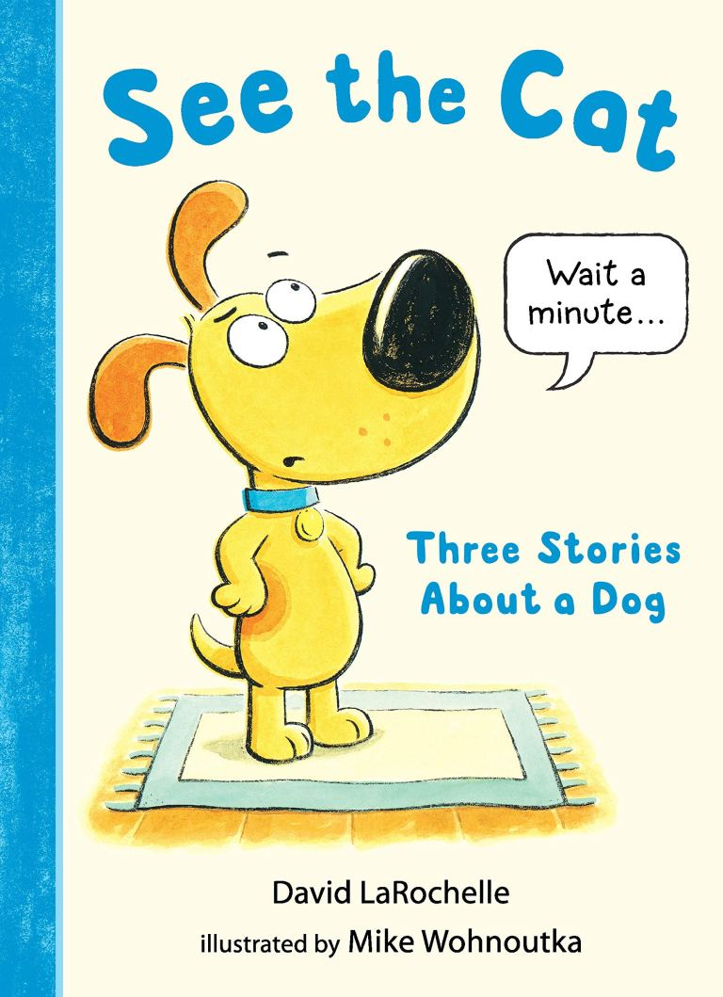
See the Cat: Three Stories About a Dog by David LaRochelle, ill. by Mike Wohnoutka
Move over, Spot. . . . spoofing classic primers, Max the Dog talks back to the book in a twist in this early reader. See Max. Max is not a cat--Max is a dog. But much to Max's dismay, the book keeps instructing readers to "see the cat." How can Max get through to the book that he is a DOG? In a trio of stories for beginning readers, author David LaRochelle introduces Max, who lets the book know that the text is not to his liking. –from Goodreads

Slide 11
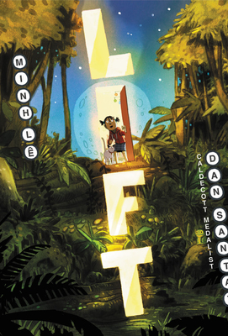
Lift by Minh Le, ill. by Dan Santat
When Iris's elevator button-pushing is disrupted by a new member of the family, she's pretty put out. That is, until the sudden appearance of a mysterious new button opens up entire realms of possibility, places where she can escape and explore on her own. But when it becomes a question between going it alone or letting someone else tag along, Iris finds that sharing a discovery with the people you love can be the most wonderful experience of all. –from Goodreads

Slide 12
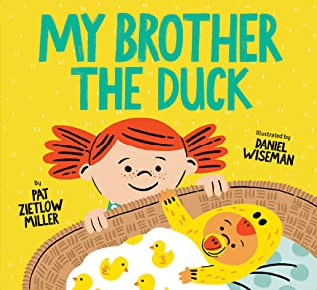
My Brother the Duck by Pat Zietlow, ill. by Daniel Wiseman
A new sibling book with humor, heart, and a dash of the scientific process sure to delight young readers. Is Stella's new baby brother a duck? All the evidence seems to be pointing in that direction, but Stella knows that scientists can't just wing it. Further research is definitely required. This sweet and silly book is just ducky for new siblings, fledgling scientists and anyone who loves a good laugh. –from Goodreads

Slide 13
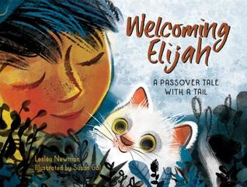
Welcoming Elijah: a Passover Tale With a Tail by Leslea Newman, ill. by Susan Gal
Uniting a young boy and a stray kitten, this warm, lyrical story is about Passover, family, and friendship. Inside, a boy and his family sit around the dinner table to embrace the many traditions of their Passover Seder around the dinner table. Outside, a cat wonders, hungry and alone. When it's time for the symbolic Passover custom of opening the family's front door for the prophet Elijah, both the boy and the cat are in for a remarkable surprise. --from Goodreads

Slide 14
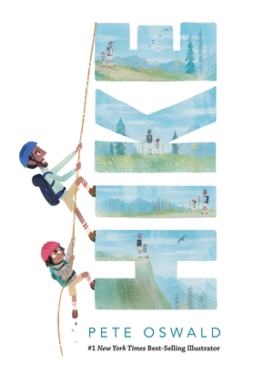
Hike by Pete Oswald
In the cool and quiet early light of morning, a father and child wake up. Today they're going on a hike. Follow the duo into the mountains as they witness the magic of the wilderness, overcome challenges, and play a small role in the survival of the forest. By the time they return home, they feel alive -- and closer than ever -- as they document their hike and take their place in family history. In detail-rich panels and textured panoramas, Pete Oswald perfectly paces this nearly wordless adventure, allowing readers to pause for subtle wonders and marvel at the views. A touching tribute to the bond between father and child, with resonant themes for Earth Day. --from Goodreads

Slide 15
Speak Up by Miranda Paul, ill. by Ebony Glenn
This spirited, picture book celebrates diversity and encourages kids to speak up, unite with others, and take action when they see something that needs to be fixed. Join a diverse group of kids on a busy school day as they discover so many different ways to speak up and make their voices heard! From shouting out gratitude for a special treat to challenging a rule that isn’t fair, these young students show that simple, everyday actions can help people and make the world a better place. –from Goodreads

Slide 16
Milo Imagines the World by Matt de la Pena, ill. by Christian Robinson
Milo is on a long subway ride with his older sister. To pass the time, he studies the faces around him and makes pictures of their lives. There's the whiskered man with the crossword puzzle; Milo imagines him playing solitaire in a cluttered apartment full of pets. There's the wedding-dressed woman with a little dog peeking out of her handbag; Milo imagines her in a grand cathedral ceremony. And then there's the boy in the suit with the bright white sneakers; Milo imagines him arriving home to a castle with a drawbridge and a butler. But when the boy in the suit gets off on the same stop as Milo--walking the same path, going to the exact same place--Milo realizes that you can't really know anyone just by looking at them. –from Goodreads

Slide 17
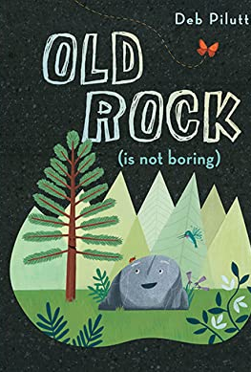
Old Rock (Is Not Boring) by Deb Pilutti
Old Rock has been sitting in the same spot in the pine forest for as long as anyone can remember. Spotted Beetle, Tall Pine, and Hummingbird think just sitting there must be boring, but they are in for a wonderful surprise. Fabulous tales of adventurous travel, exotic scenery, entertaining neighbors, and more from Old Rock's life prove it has been anything but boring. Great storytellers come in all shapes, sizes, and ages, and Old Rock's stories are sure to inspire questions that lead to wonderful conversations about the past and the natural world. –from Goodreads

Slide 18
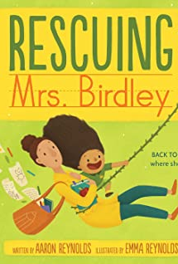
Rescuing Mrs. Birdley by Aaron Reynolds, ill. by Emma Reynolds
Miranda is an animal expert. Or at least, she watches a lot of Nature Joe. Nature Joe is incredible. He rescues animals, returning them to their natural habitat. Mrs. Birdley is a teacher. The natural habitat of a teacher is a classroom. So when Mrs. Birdley escapes school and ends up wild, loose, and confused at the local grocery store, Miranda knows just what to do: she must use her brain, her guts, and her extensive knowledge of Nature Joe to rescue Mrs. Birdley—at any cost!
–from Goodreads

Slide 19
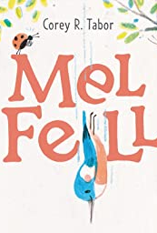
Mel Fell by Corey R. Tabor
A charming and innovative tale--starring an adorable, brave kingfisher--about self-confidence and taking a leap of faith. Sometimes, you might fall down, down, down, before you learn to fly up, up, up…

Slide 20
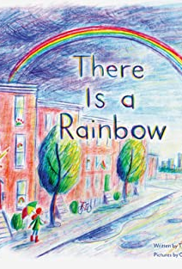
There Is a Rainbow by Theresa Trinder, ill. by Grant Snider
Sometimes we are separated by distance, sometimes by the way we feel. Even though the world is full of barriers that can make us feel unconnected, we are all just on one end of a rainbow. Connected by all that color and light, there is always something, or someone, waiting for us on the other side. Poetically told with an uplifting message for some of life's most difficult moments, this book encourages readers to look past their immediate surroundings and find comfort, community, and inner courage—all are closer than we might think. --from Goodreads

Slide 21
The Blue House by Phoebe Wahl
For as long as he can remember, Leo has lived in the blue house with his dad, but lately the neighborhood is changing. People are leaving, houses are being knocked down and shiny new buildings are going up in their place. When Leo and his dad are forced to leave, they aren't happy about it. They howl and rage and dance out their feelings. When the time comes, they leave the blue house behind--there was never any choice, not really--but little by little, they find a way to keep its memory alive in their new home. –from Goodreads

