Slide 1
2019-2020 Volunteer State Book Award Middle School Division

Slide 2
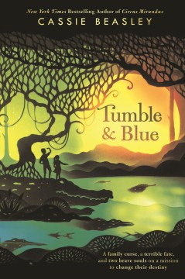
Tumble & Blue by Cassie Beasley
In order for Tumble Wilson and Blue Montgomery to fix their ancestors' mistakes and banish the bad luck that has followed them around for all of their lives, they must face Munch, the mysterious golden alligator who cast the curse centuries ago.
Lexile: 680L

Slide 3
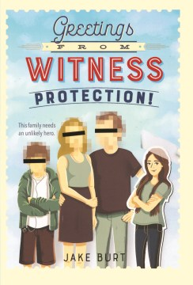
Greetings From Witness Protection! by Jake Burt
Thirteen-year-old Nikki Demere is an orphan and a kleptomaniac, making her the perfect girl to portray the Trevors' daughter in witness protection, but she soon learns that the biggest threat to her new family's security comes from her own past.
Lexile: 750L

Slide 4
The Last Cherry Blossom by Kathleen Burkinshaw
Yuriko is happy growing up in Hiroshima with her Papa, but things quickly change when her aunt Kimiko and her cousin Genji begin living with them and the family threatens to get bigger with talk of a double marriage! However, the world beyond their doors is even more unpredictable. World War II is coming to an end, and Japan's fate is not entirely clear. When the atomic bomb hits Hiroshima, it's through Yuriko's twelve-year-old eyes that we witness the devastation and horror.
Reading Level: 6.5

Slide 5
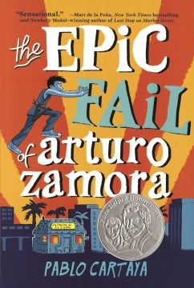
The Epic Fail of Arturo Zamora by Pablo Cartaya
The story of 13-year-old Arturo, who is looking forward to a relaxing summer until Carmen, a cute and funny girl moves into his apartment complex. While he deals with his stomach turning into a deep fryer over a girl, a smarmy land developer rolls into town and threatens to change it.
Lexile: 750L

Slide 6
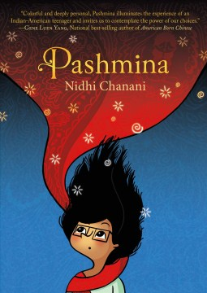
Pashmina by Nidhi Chanani
In this debut graphic novel, teenaged Priyanka’s mother's homeland of India can only exist in her imagination. That is, until she finds a mysterious pashmina tucked away in a forgotten suitcase. When she wraps herself in it, she is transported to a place more vivid and colorful than any guidebook or Bollywood film. But is this the real India? And what is that shadow lurking in the background? To learn the truth Pri must travel farther than she's ever dared and find the family she never knew.
Lexile: GN240L

Slide 7
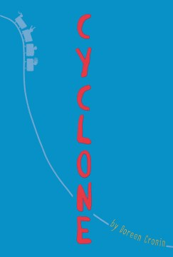
Cyclone by Doreen Cronin
Blaming herself when the cousin she dragged onto a roller coaster falls into a coma, Nora struggles with unendurable guilt and tries to help when her cousin awakens with challenging disabilities.
Lexile: 600L

Slide 8
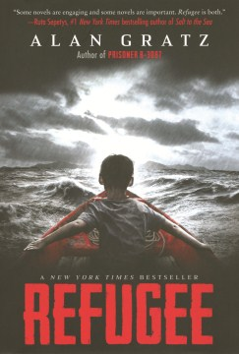
Refugee by Alan Gratz
Although separated by continents and decades, Josef, a Jewish boy livng in 1930s Nazi Germany; Isabel, a Cuban girl trying to escape the riots and unrest plaguing her country in 1994; and Mahmoud, a Syrian boy in 2015 whose homeland is torn apart by violence and destruction, embark on harrowing journeys in search of refuge, discovering connections tying their stories together.
Lexile: 800L

Slide 9
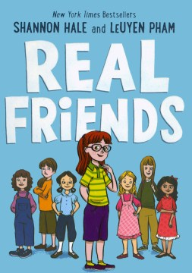
Real Friends by Shannon Hale and LeUyen Pham
The graphic memoir of Shannon Hale in which she reflects on her childhood friendships. As the middle child between two older and two younger close-in-age siblings, young Shannon feels lost within her family, and at school, where it’s a similar situation with her never quite fitting in anywhere. As the story progresses and Shannon’s anxiety becomes more evident, each chapter focuses on a pivotal relationship and demonstrates the shifting loyalties, petty jealousies, and moments of short-lived triumph common to childhood friendships.
Lexile: GN290L

Slide 10
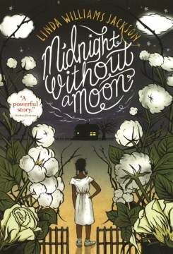
Midnight Without a Moon by Linda Williams Jackson
Rose Lee Carter, a thirteen-year-old African-American girl, dreams of life beyond the Mississippi cotton fields during the summer of 1955. When Emmett Till is murdered and his killers are unjustly acquitted, Rose is torn between seeking her destiny outside of Mississippi or staying and being a part of an important movement.
Lexile: 870L

Slide 11
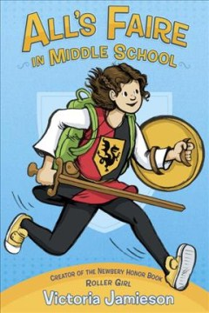
All’s Faire in Middle School by Victoria Jamieson
Homeschooled by Renaissance Fair enthusiasts, eleven-year-old Imogene has a hard time fitting in when her wish to enroll in public school is granted. A coming-of-age story told in graphic novel format.
Lexile: GN460L

Slide 12
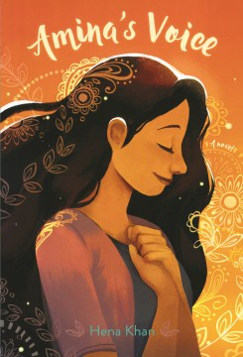
Amina’s Voice by Hena Khan
A Pakistani-American Muslim girl struggles to stay true to her family's vibrant culture while simultaneously blending in at school after tragedy strikes her community.
Lexile: 800L

Slide 13
Warcross by Marie Lu
When teenage coder, Emika Chen, hacks her way into the opening tournament of the Warcross Championships, she glitches herself into the game as well as a sinister plot with major consequences for the entire Warcross empire.
Lexile: 810L

Slide 14
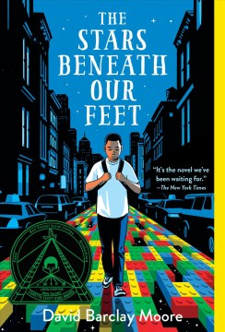
The Stars Beneath Our Feet by David Barclay Moore
Twelve-year-old Wallace “Lolly” Rachpaul lives in the Harlem projects. Lolly copes with the death of his older brother, Jermaine, due to “crew” violence, by making masterpieces with the LEGOs his mom’s girlfriend, Yvonne, brings him. When he makes his own world with LEGOs and creates a game around it after school with a new friend Rose, things seem to be looking up. But when crew members interested in recruiting Wallace start following him around, and his best friend Vega thinks about joining, Wallace must confront his grief and the events that led up to his brother’s death.
Lexile: 650L

Slide 15
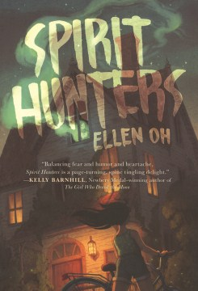
Spirit Hunters by Ellen Oh
Harper doesn't trust her new home from the moment she steps inside, and the rumors are that the Raine family's new house is haunted. Harper isn't sure she believes those rumors, until her younger brother, Michael, starts acting strangely. The whole atmosphere gives Harper a sense of deja vu, but she can't remember why. She knows that the memories she's blocking will help make sense of her brother's behavior and the strange and threatening sensations she feels in this house, but will she be able to put the pieces together in time?
Lexile: 680L

Slide 16
The First Rule of Punk by Celia C. Perez
Twelve-year-old Maria Luisa O'Neill-Morales (Malu) reluctantly moves with her Mexican-American mother to Chicago and starts seventh grade with a bang--violating the dress code with her punk rock aesthetic and spurning the middle school's most popular girl in favor of starting a band with a group of like-minded weirdos.
Lexile: 670L

Slide 17
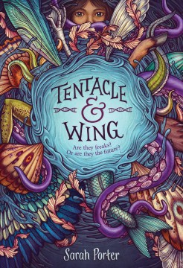
Tentacle & Wing by Sarah Porter
Twelve-year-old Ada is a Chimera, someone born with human and animal DNA thanks to a genetic experiment gone wrong. When she is shipped off to a quarantined school for other kids like herself, she senses that the facility is keeping a secret, which, if discovered, could upend everything the world knows about how Chimeras came into being.
Lexile: 750L

Slide 18
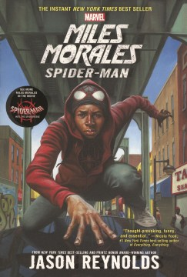
Miles Morales: Spider-Man by Jason Reynolds
Brooklyn Visions Academy student Miles Morales may not always want to be a super hero, but he must come to terms with his identity--and deal with a villainous teacher--as the new Spider Man.
Lexile: HL710L

Slide 19
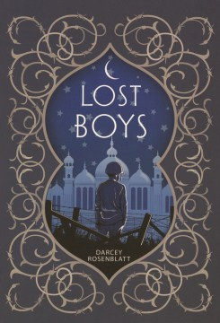
Lost Boys by Darcey Rosenblatt
In 1982 Iran, twelve-year-old Reza is more interested in music than war, but enlists in obedience to his devout mother and soon finds himself in a prison camp in Iraq.
Lexile: HL640L

Slide 20
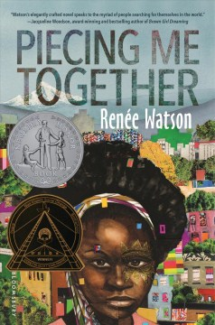
Piecing Me Together by Renee Watson
Tired of being singled out at her mostly-white private school as someone who needs support, high school junior Jade would rather participate in the school's amazing Study Abroad program than join Women to Women, a mentorship program for at-risk girls.
Lexile: 680L

Slide 21
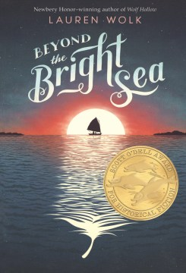
Beyond the Bright Sea by Lauren Wolk
Crow has lived her entire life on a tiny island off the coast of Massachusetts. Her only companions are Osh, the man who rescued her as an infant and raised her, and Miss Maggie, their neighbor across the sandbar. But it isn't until the night when a mysterious fire appears across the water that an unspoken question of her own history forms in her heart and an unstoppable chain of events is triggered. Using her bravery and perseverance, Crow must follow clues that not only lead to a personal treasure, but to uncovering her lost identity and, ultimately, understanding what it means to be a family.
Lexile: 770L

