Slide 1
2018-2019 Volunteer State Book Award Primary Division

Slide 2
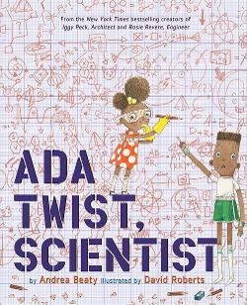
Ada Twist, Scientist by Andrea Beaty and Illustrated by David Robert
Ada Twist is a very curious girl who shows perseverance by asking questions and performing experiments to find things out and understand the world.

Slide 3
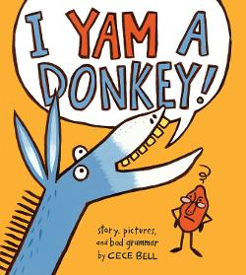
I Yam a Donkey! By Cece Bell
Confusion abounds when a poorly spoken donkey says to a grammarian yam, "I Yam a Donkey!"

Slide 4
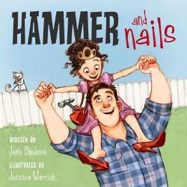
Hammer and Nails by Josh Bledsoe & illustrated by Jessica Warrick
After her play date is cancelled, a young girl and her dad have a fun day tackling their to-do lists together.

Slide 5
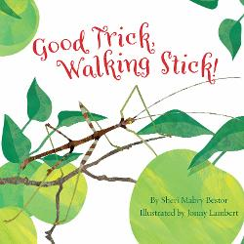
Good Trick, Walking Stick! By Sheri Mabry Bestor & Illustrated by Jenny Lambert
This book follows the life of a walking stick, including how they change colors to blend in with their surroundings.

Slide 6
Our Great Big Back Yard by Laura Bush and Jenna Bush Hager Illustrated by Jacqueline Rogers
Jane’s plans of spending the summer playing video games with her friends are dashed when her parents announce that her family is going on a road trip to national parks around the country.

Slide 7
Maybe Something Beautiful by Isabel Campoy and Illustrated by Rafael Lopez
Mira lives in a gray and hopeless urban community until a muralist arrives and, along with his paints and brushes, brings color, joy, and togetherness to Mira and her neighbors.

Slide 8
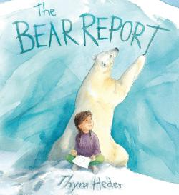
The Bear Report by Thyra Heder
Sophie is uninterested in writing a research report on polar bears until a polar bear named Olafur swoops her away to the Arctic, where she learns all about the playful bear's habits and habitat, from glacier mice to Northern Lights.

Slide 9
Antsy Ansel: A Life in Nature by Cynthia Jenson-Elliott & Illustrated by Christy Hale
This biography chronicles the life of Ansel Adams from a restless boy to the iconic nature photographer.

Slide 10
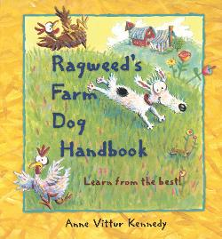
Ragweed’s Farm Dog Handbook by Anne Vittur Kennedy
This book describes Ragweed's handy tips to become the best farm dog ever.

Slide 11
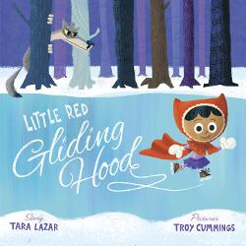
Little Red Gliding Hood by Tara Lazer & Illustrated by Troy Cummings
Little Red is an excellent ice skater, but she will need a good partner for the skating pairs competition and the only one available is a certain Wolf, who needs new skates as badly as Little Red does.

Slide 12
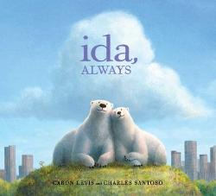
Ida, Always by Caron Levis & Illustrated by Charles Santoso
A beautiful, honest portrait of loss and deep friendship told through the story of two iconic polar bears.

Slide 13
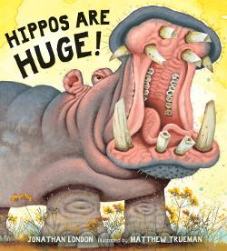
Hippos Are Huge! by Jonathan London & Illustrated by
Hippos have razor-sharp tusks, weigh as much as fifty men, and can run twenty-five miles per hour! Readers follow these hefty hippos as they glide underwater, play tug-of-war, swat balls of dung at one another, and nuzzle their young in the mud.

Slide 14
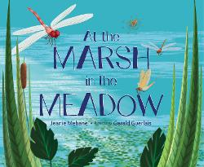
At the Marsh in the Meadow by Jeanie Mebane & illustrated by Gerald Guerlais
The poems in this book portray the wetlands food chain, showing how all forms of life, from the mud at the bottom of the marsh to the birds in the sky.

Slide 15
The Quickest Kid in Clarksville By Pat Zietlow Miller & illustrated by Frank Morrison
Growing up in the segregated town of Clarksville in the 1960s, Alta's family cannot afford to buy her new sneakers. She still plans to attend the parade celebrating her hero Wilma Rudolph's three Olympic gold medals.

Slide 16
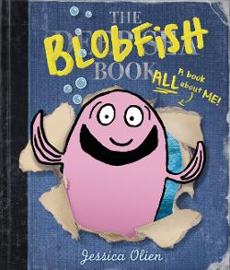
The Blobfish Book by Jessica Olien
This true story about the blobfish is full of fun facts about sea creatures in the deepest reaches of the ocean.

Slide 17
Madeline Finn and the Library Dog by Lisa Papp
Reluctant reader Madeline really wants to earn a star at school, so when Mrs. Dimple, the librarian, suggests that she read aloud to a dog, Madeline gives it a try.

Slide 18
School’s First Day of School by Adam Rex & Illustrated by Christian Robinson
It's the first day of school at Frederick Douglass Elementary and everyone's just a little bit nervous, especially the school itself.

Slide 19
Bob, Not Bob! By Liz Garton Scanlon & Audrey Vernick & illustrated by Matthew Cordell
When a young boy gets a cold, he just wants his mommy. His stuffy nose makes it difficult for him to call out to his mom--not 'Bob,' who happens to be the family dog.

Slide 20
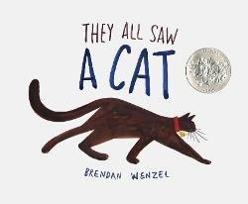
They All Saw a Cat by Brendan Wenzel
In simple, rhythmic prose and stylized pictures, a cat walks through the world, and all the other creatures see and acknowledge the cat.

Slide 21
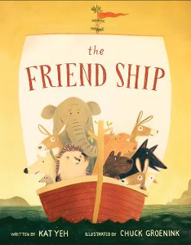
The Friend Ship by Kat Yeh & illustrated by Chuck Groenink
A lonely hedgehog sets out on an adventure to find friendship.

