Slide 1
2018-2019 Volunteer State Book Award Middle School Division

Slide 2
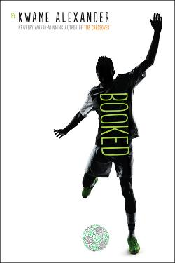
Booked by Kwame Alexander
Nick loves soccer and hates books, but he soon learns the power of words as he wrestles with problems at home, stands up to a bully, and tries to impress the girl of his dreams.

Slide 3
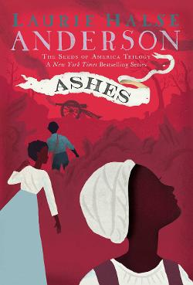
Ashes by Laurie Halse Anderson
As the Revolutionary War rages on, Isabel and Curzon have narrowly escaped the horrors of Valley Forge--but their relief is short-lived. Before long, they are reported as runaways and chased as they flee South to find Isabel’s little sister.

Slide 4
The Girl Who Drank the Moon by Kelly Barnhill
A young girl is raised by a witch, a swamp monster, and a Perfectly Tiny Dragon, who must work together to unlock the powerful magic buried deep inside her.

Slide 5
The Forgetting by Sharon Cameron
Nadia lives in Canaan, a quiet city in an idyllic world. Every twelve years, the people of Canaan undergo a collective Forgetting, after which they are left without any trace of memory of themselves, their families, or their lives. Nadia, however, has never forgotten.

Slide 6
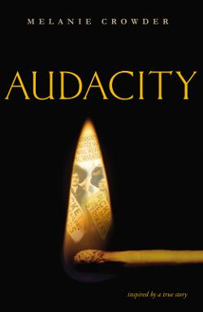
Audacity by Melanie Crowder
This verse novels shows the inspiring story of Clara Lemlich and her fight for equal rights led to the largest strike by women in American history.

Slide 7
The Boys Who Challenged Hitler by Phillip Hoose
During WWII, a small group of Danish teens committed countless acts of sabotage against the Germans who eventually find and arrest the boys. Their efforts were not in vain as their exploits and eventual imprisonment helped to spark a full-blown resistance.

Slide 8
Scar Island by Dan Gemeinhart
Jonathan Grisby is the newest arrival at the Slabhenge Reformatory School for Troubled Boys--an ancient, crumbling fortress of gray stone rising up from the ocean. After an accident kills all of the adults, the boys must fend themselves.

Slide 9
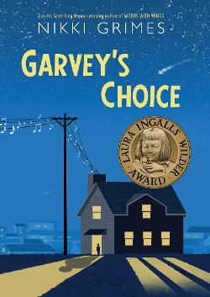
Garvey’s House by Nikki Grimes
Preferring science and reading to the sports his father wants him to play, Garvey comforts himself with food and endures bullying before joining the school chorus, where he learns how to accept himself and bond with his father.

Slide 10
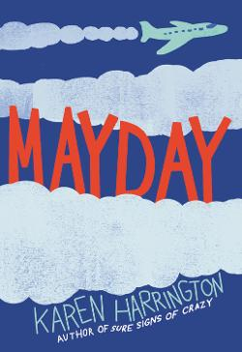
Mayday by Karen Harrington
Wayne loses his uncle to war and his voice to a plane crash in the same year and must learn to speak up as he navigates relationships with his father, grandfather, and new friend.

Slide 11
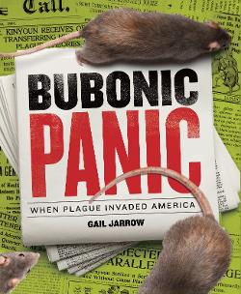
Bubonic Panic by Gail Jarrow
This book tells the grisly true story of America's first plague epidemic--the public health doctors who desperately fought to end it, the political leaders who tried to keep it hidden, and the brave scientists who uncovered the plague's secrets.

Slide 12
Night on Fire by Ronald Kidd
When Billie hears about a group calling themselves the Freedom Riders passing through Alabama to protest segregation on buses, she thinks change could be coming. Instead of embracing this change, her town responds with violence, and she finds herself at a grocery store watching a bus burn and wondering what to do next.

Slide 13
Strong Inside by Andrew Maraniss
When Vanderbilt recruited Perry Wallace to play basketball, he courageously accepted the assignment to help desegregate the Southeastern Conference. The hateful experiences he would endure on campus and in the hostile gymnasiums of the Deep South became the stuff of nightmares. Yet Wallace persisted, endured, and met this unthinkable challenge head on.

Slide 14
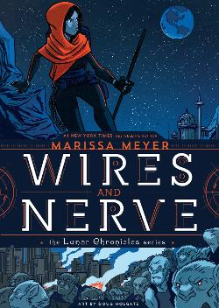
Wires & Nerves by Marissa Meyer
In this graphic companion to the Lunar Chronicles, android Iko takes it upon herself to hunt down the leader of a wolf rebellion.

Slide 15
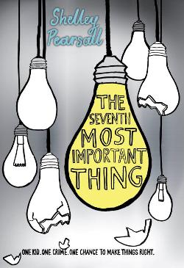
The Seventh Most Important Thing by Shelley Pearsall
Arthur is sentenced to community service helping the neighborhood Junk Man after he throws a brick at the old man's head in a moment of rage. Arthur soon realizes that the junk he collects might be more important than he suspects.

Slide 16
Ghost by Jason Reynolds
Ghost, a naturally talented runner and erstwhile troublemaker, is recruited for an elite middle school track team. He must stay on track, literally and figuratively, to reach his full potential.

Slide 17
Hidden Figures by Margot Lee Shetterly
This non-fiction title describes the true story of the African-American female mathematicians at NASA whose calculations helped fuel some of America's greatest achievements in space.

Slide 18
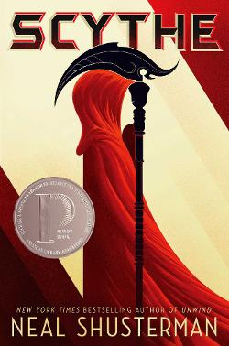
Scythe by Neal Shusterman
In a world where disease has been eliminated, the only way to die is to be randomly killed by professional reapers called scythes. Rowan and Citra must compete with each other to become a scythe--a position neither of them wants. The one who wins the competition must kill the other.

Slide 19
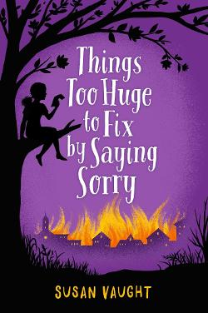
Things Too Huge To Fix by Saying Sorry by Susan Vaught
A family mystery leads Dani to investigate the secrets of the University of Mississippi and the dark history of race relations in Oxford.

Slide 20
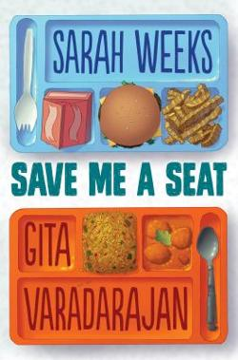
Save Me a Seat by Sarah Weeks and Gita Varadarajan
Ravi has just moved to the United States from India and has always been at the top of his class; Joe has lived in the same town his whole life and has learning problems. When their lives intersect in the first week of fifth grade, they are brought together by the biggest bully in their class and the need to take control of their lives.

Slide 21
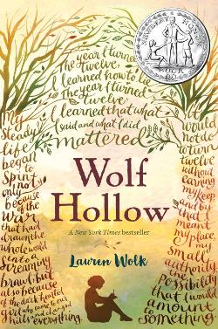
Wolf Hollow by Lauren Wolk
Annabelle must learn to stand up for what's right in the face of a manipulative and violent bully who targets people she cares about, including a homeless World War I veteran.

