Slide 1
2018-2019 Volunteer State Book Award High School Division

Slide 2
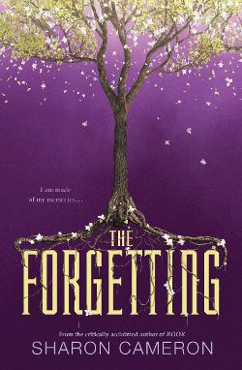
The Forgetting by Sharon Cameron
Nadia lives in Canaan, a quiet city in an idyllic world. Every twelve years, the people of Canaan undergo a collective Forgetting, after which they are left without any trace of memory of themselves, their families, or their lives. Nadia, however, has never forgotten.

Slide 3
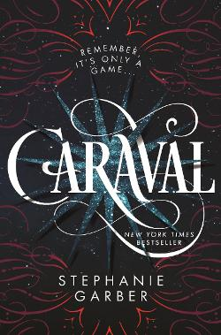
Caraval by Stephanie Garber
Scarlett and Tella leave their cruel father to attend Caraval, an annual performance where the audience participates in the show. Along the way, Tella is kidnapped, and Scarlett soon finds herself trapped in a game of love, heartbreak, and magic.

Slide 4
The Boys Who Challenged Hitler by Phillip Hoose
During WWII, a small group of Danish teens committed countless acts of sabotage against the Germans who eventually find and arrest the boys. Their efforts were not in vain as their exploits and eventual imprisonment helped to spark a full-blown resistance.

Slide 5
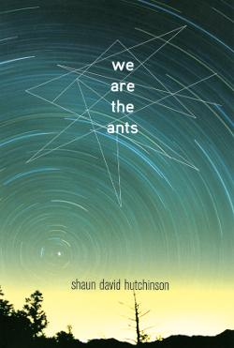
We Are the Ants by Shaun David Hutchinson
Abducted by aliens periodically throughout his youth, Henry is informed by his captors that they will destroy the world in 144 days unless he can convince that humanity is worth saving.

Slide 6
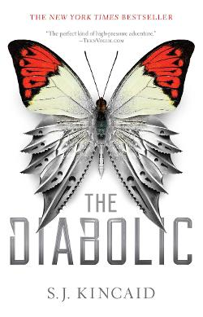
The Diabolic by S.J. Kincaid
Nemesis is a Diabolic, a genetically modified teenager and the galaxy's most deadly weapon. She masquerades as Sidonia, a senator's daughter, and then becomes a hostage of the galactic court.

Slide 7
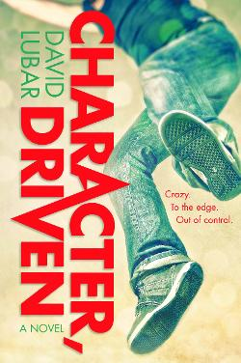
Character, Driven by David Lubar
In his last year of high school, Cliff Sparks has to figure out what to do with his life, including how to meet new girl Jillian and how to deal with old issues with his unemployed father.

Slide 8
The Female of the Species by Mindy McGinnis
Alex Craft knows how to kill someone but she doesn't feel guilty about it. Her older sister was raped and murdered three years ago. When the killer walks free, she seeks vengeance against him.

Slide 9
Burn Baby Burn by Meg Medina
Nora Lopez is coming of age during the infamous New York summer of 1977 when the city is besieged by arson, a massive blackout, and a serial killer named Son of Sam.

Slide 10
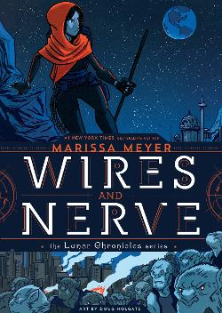
Wires & Nerves by Marissa Meyer
In this graphic companion to the Lunar Chronicles, android Iko takes it upon herself to hunt down the leader of a wolf rebellion.

Slide 11
The Borden Murders by Sarah Miller
The story of Lizzie Borden—accused of killing her wealthy parents in grisly fashion—is detailed in this non-fiction work of true crime.

Slide 12
Born a Crime by Trevor Noah
This humorous memoir describes Trevor Noah's unlikely path from apartheid South Africa to the desk of The Daily Show . Trevor was born to a white Swiss father and a black Xhosa mother at a time when such a union was punishable by five years in prison.

Slide 13
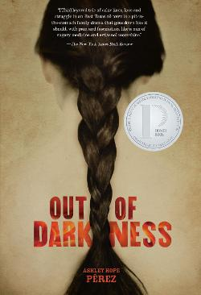
Out of Darkness by Ashley Hope Perez
Against the backdrop of the New London disaster, Wash and Naomi fall in love in a climate surrounded by racism, tragedy, and abuse.

Slide 14
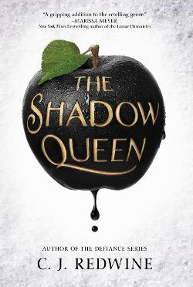
The Shadow Queen by C.J. Redwine
In this dark retelling of Snow White, an exiled princess is pursued by a magic-wielding prince who serves as the personal huntsman for evil queen Irina and who has been charged with bringing her Lorelai's heart.

Slide 15
If I Was Your Girl by Meredith Russo
Amanda Hardy wants to fit in at her new school, but she has a big secret about her past. When she falls for Grant, she finds herself yearning to share with him everything about herself.

Slide 16
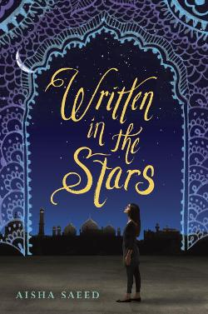
Written in the Stars by Aisha Saeed
Naila's vacation to visit relatives in Pakistan turns into a nightmare when she discovers her parents want to force her to marry a man she's never met.

Slide 17
This Savage Song by Victoria Schwab
In this dark urban fantasy, a young woman and a young man must choose whether to become heroes or villains—and friends or enemies—with the future of their home at stake.

Slide 18
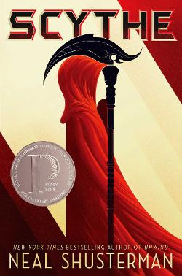
Scythe by Neal Shusterman
In a world where disease has been eliminated, the only way to die is to be randomly killed by professional reapers called scythes. Rowan and Citra must compete with each other to become a scythe--a position neither of them wants. The one who wins the competition must kill the other.

Slide 19
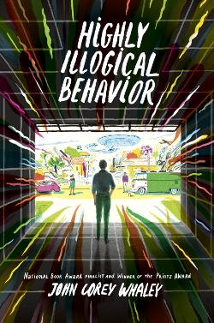
Highly Illogical Behavior by John Corey Whaley
Agoraphobic Solomon has not left his house in three years, but Lisa is determined to change that--and to write a scholarship-winning essay based on the results. This novel showcases the different ways we hide ourselves from the world--and how love, tragedy, and the need for connection may be the only things to bring us back into the light.

Slide 20
The Sun Is Also a Star
Natasha is a girl who believes in science and facts. Daniel has always been a good son and good student. When he sees Natasha for the first time, he forgets all that and believes there is something extraordinary in store for both of them in spite of the fact that Natasha’s family faces deportation in a few hours.

Slide 21
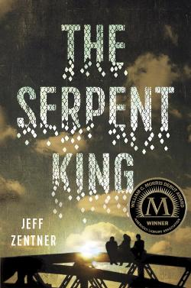
The Serpent King by Jeff Zentner
Dill, the son of a snake handling preacher, faces his personal demons as he and his two outcast friends try to make it through their senior year of high school in rural Tennessee without letting the small-town culture destroy their creative spirits and sense of self.

