Slide 1
2016-2017 Volunteer State Book Award Primary Division

Slide 2
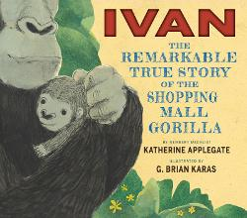
Ivan: the Remarkable True Story of the Shopping Mall Gorilla by Katherine Applegate and Illustrated by Brian Karas
The true story of Ivan, known as the Shopping Mall Gorilla, who lived alone in a small cage for almost 30 years before being relocated to the gorilla habitat at ZooAtlanta

Slide 3
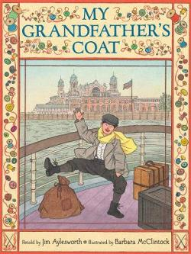
My Grandfather’s Coat by Jim Aylesworth and illustrated by Barbara McClintock
A tailor's very old overcoat is recycled numerous times over the years into a variety of garments and other uses.

Slide 4
Knock Knock: My Dad’s Dream for Me by Daniel Beaty and Illustrated by Bryan Collier
A boy wakes up one morning to find his father gone. At first, he feels lost, but his father has left him a letter filled with advice to guide him through the times he cannot be there.

Slide 5
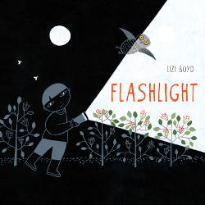
Flashlight by Lizi Boyd
A boy explores the woods after dark with a flashlight and discovers there is an exciting world outside at night.

Slide 6
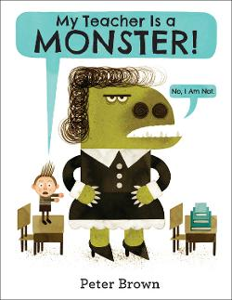
My Teacher is a Monster by Peter Brown
Bobby thinks his teacher, Ms. Kirby, is horrible, but when he sees her outside of school and they spend a day in the park together, he discovers she might not be so bad after all.

Slide 7
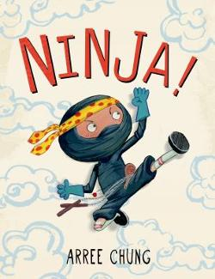
Ninja! by Arree Chung
A ninja must be strong, courageous, and silent! He creeps through the house on a secret mission. There may be obstacles! But have no fear—a true ninja can overcome all challenges.

Slide 8
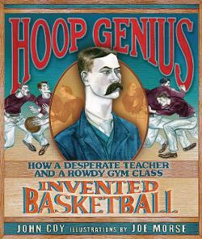
Hoop Genius by John Coy and Illustrated by Joe Morse
The book tells the story of why and how James Naismith invented the game of basketball for his rowdy gym class.

Slide 9
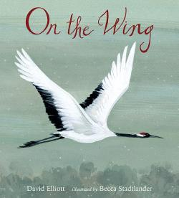
On the Wing by David Elliott and Illustrated by Becca Stadtlander
This illustrated book offers a collection of humorous poems about birds.

Slide 10
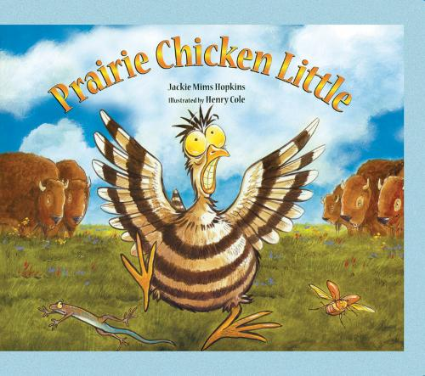
Prairie Chicken Little by Jackie Mims Hopkins and Illustrated by Henry Cole
Mary McBlicken, a small prairie chicken, and her animal friends are on their way to tell Cowboy Stan and Red Dog Dan that a stampede is coming when they meet a hungry coyote.

Slide 11
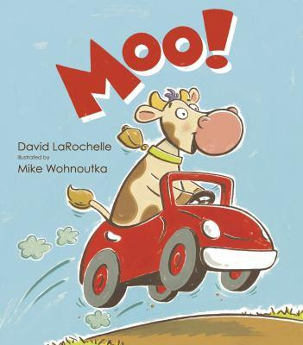
Moo! By David LaRochelle and Illustrated by Mike Wohnoutka
When Cow gets her hooves on the farmer's car, she takes it for a wild ride through the country.

Slide 12
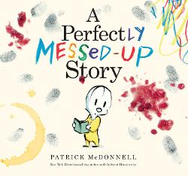
A Perfectly Messed‐Up Story by Patrick McDonnell
Louie becomes angry when the story in which he appears is ruined by messes from jelly, peanut butter, and other things that do not belong in books.

Slide 13
Maple by Lori Nichols
When Maple is tiny, her parents plant a maple tree in her honor. She and her tree grow up together, and even though a tree doesn't always make an ideal playmate, it doesn't mind when Maple is in the mood to be loud - which is often. Then Maple becomes a big sister, and finds that babies have their loud days, too. Fortunately, Maple and her beloved tree know just what the baby needs

Slide 14
The Book With No Pictures by B.J. Novak
In this book with no pictures, the reader has to say every silly word, no matter what it is.

Slide 15
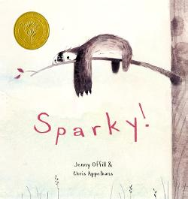
Sparky! by Jenny Offill and Illustrated by Chris Appelhans
When a childs orders a sloth through the mail, the creature that arrives isn't good at tricks or hide-and-seek . . . or much of anything. Still, there's something about Sparky that is irresistible.

Slide 16
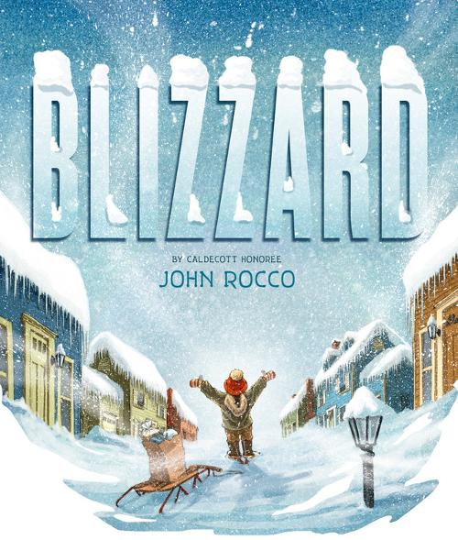
Blizzard! By John Rocco
After a massive blizzard, a boy becomes a hero when he manages to walk to the local store and bring supplies back to his neighborhood which has been snowed in for days.

Slide 17
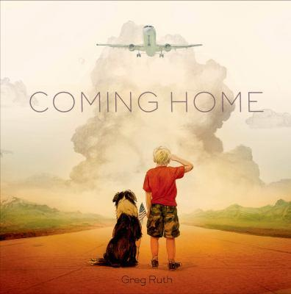
Coming Home by Greg Ruth
This book follows the emotions of a young boy as he waits at an airport for a family member to return home from serving in the military.

Slide 18
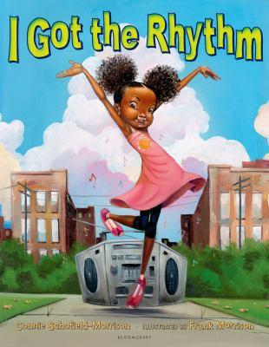
I Got The Rhythm by Connie Schofield‐Morrison and Illustrated by Frank Morrison
On a trip to the park with her mother, a young girl hears a rhythm coming from the world around her and begins to move to the beat, finally beginning an impromptu dance in which other childen join her.

Slide 19
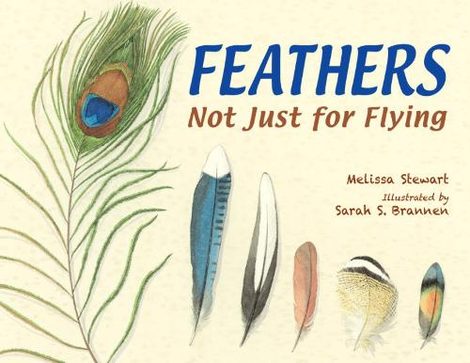
Feathers: Not Just for Flying by Melissa Stewart and Illustrated by Sarah Brannen
Readers meet sixteen different types of birds and learn about the various uses for feathers.

Slide 20
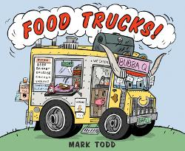
Food Trucks by Mark Todd
This fun book uses illustrations and short rhymes to introduce food trucks and the many treats they offer…from a full breakfast to a cupcake.

Slide 21
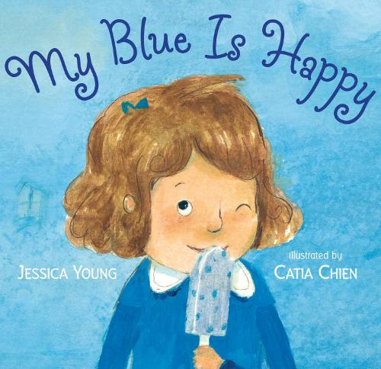
My Blue is Happy by Jessica Young and Illustrated by Catia Chien
A young girl explores emotions that are associated with different colors and begins to understand individual perspective.

