Slide 1
Breakout EDU
This session presented by: Lakisha Brinson @LakishaBrinson lbrinson@email.usn.org
Original Presentation done in collaboration w/ :
Mark Littlefield @LittleMarkField
Notes:
Intro Mark: 8 minutes
Break-out 15 minutes
Celebrations 2 minutes
Practical Applications: 8 minutes
Questions and Answer 7 minutes

Slide 2
Notes:
Plays off the idea of the escape game. Started around 2001. Many played escape games on consoles and how are transitioning into the BrekoutEDU game.

Slide 3
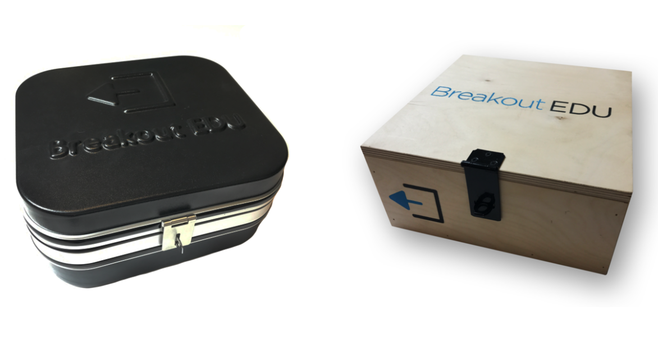
Notes:
This is a real breakoutEDu box. If you buy from the site, the wooden one will cost $119 and the plastic will cost $89. It comes will all of the locks. However, don’t feel that you have to use their boxes.

Slide 4
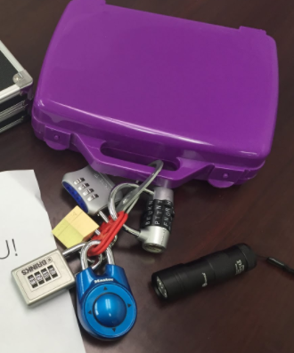
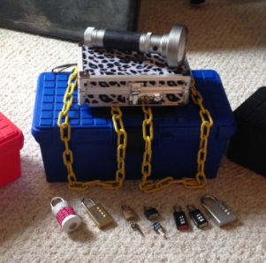

Slide 5
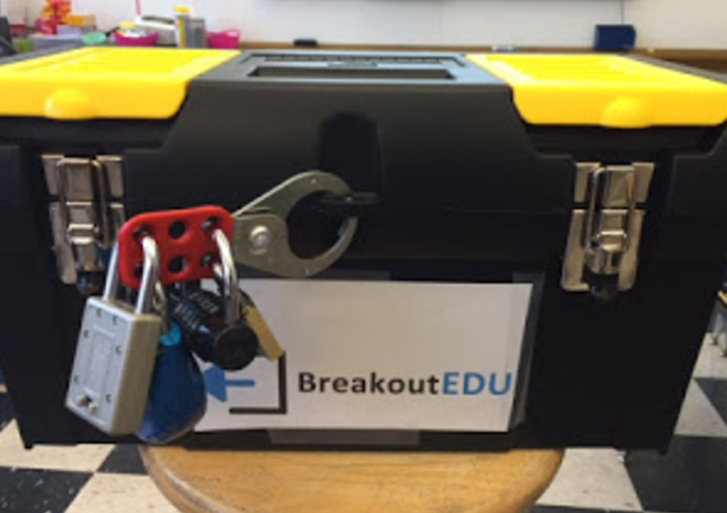
Notes:
You basically just need a box you can put the hasp on, which is the red thing.

Slide 6
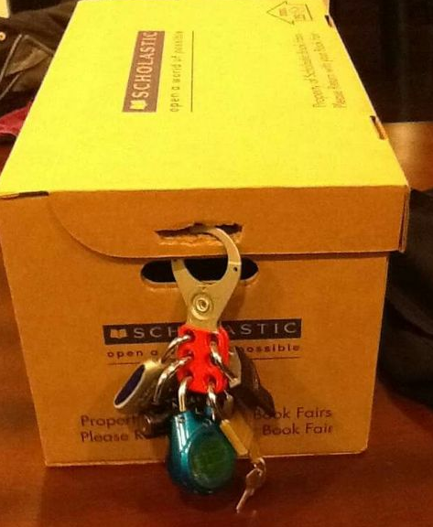

Slide 7
Notes:
Go on Amazon and purchase this stuff yourself.

Slide 8
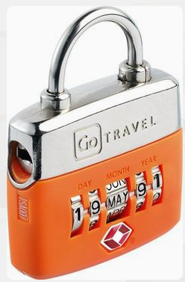
Extra Locks

Slide 9
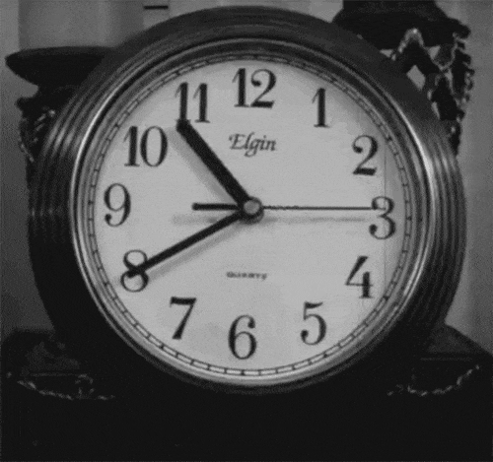
http://tinyurl.com/yd2jlej7
Notes:
We are giving you partial passwords and clues to speed this process. If you do not breakout by x time, we’ll tell you the codes.

Slide 11
How it started
2 Tech Coordinators
4 boxes
Desire to provide our students with an engaging yet authentic activity

Slide 12
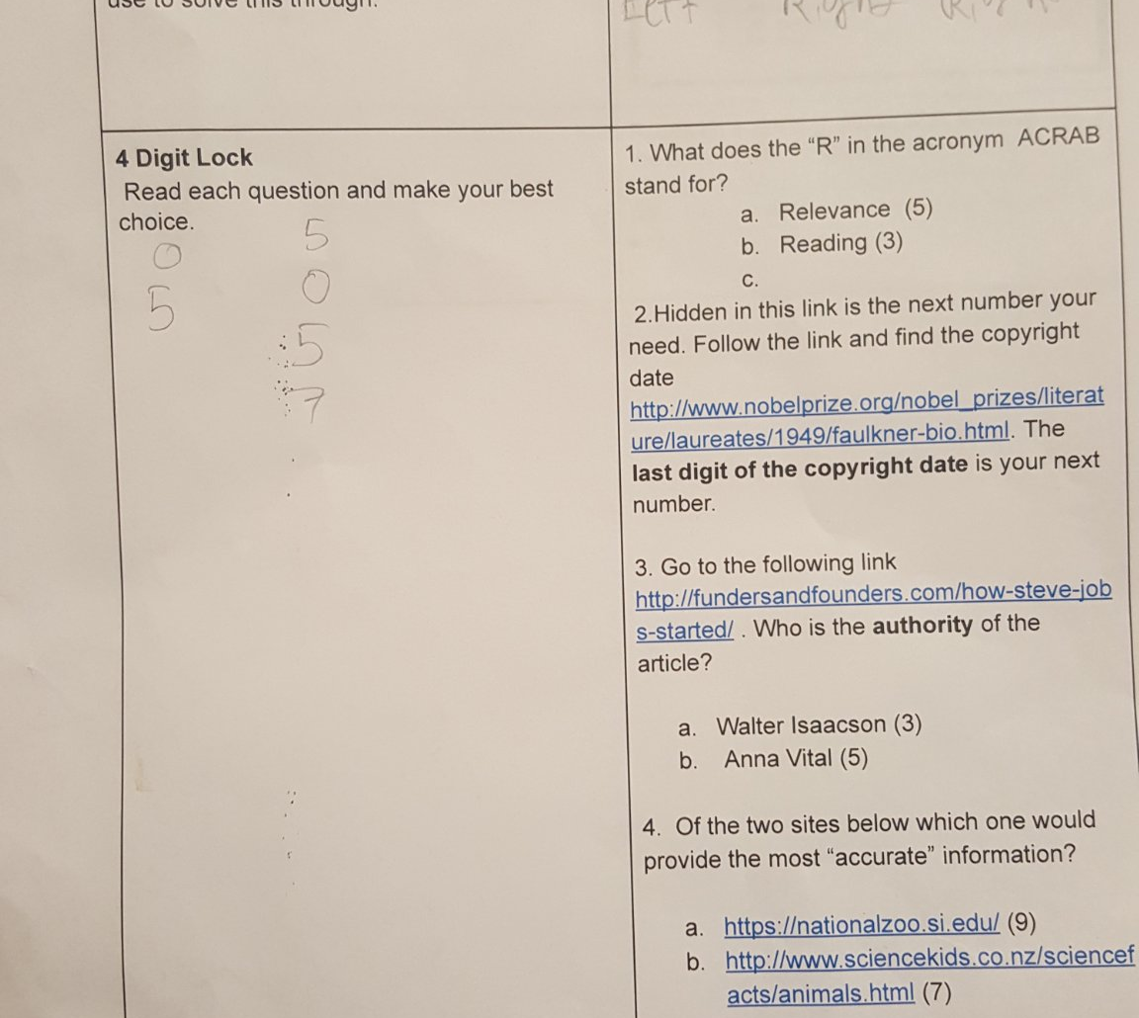
Lesson Structure
2 Instructors
Familiar Topic
5th grade students
one device per group
45 minutes time slot

Slide 13
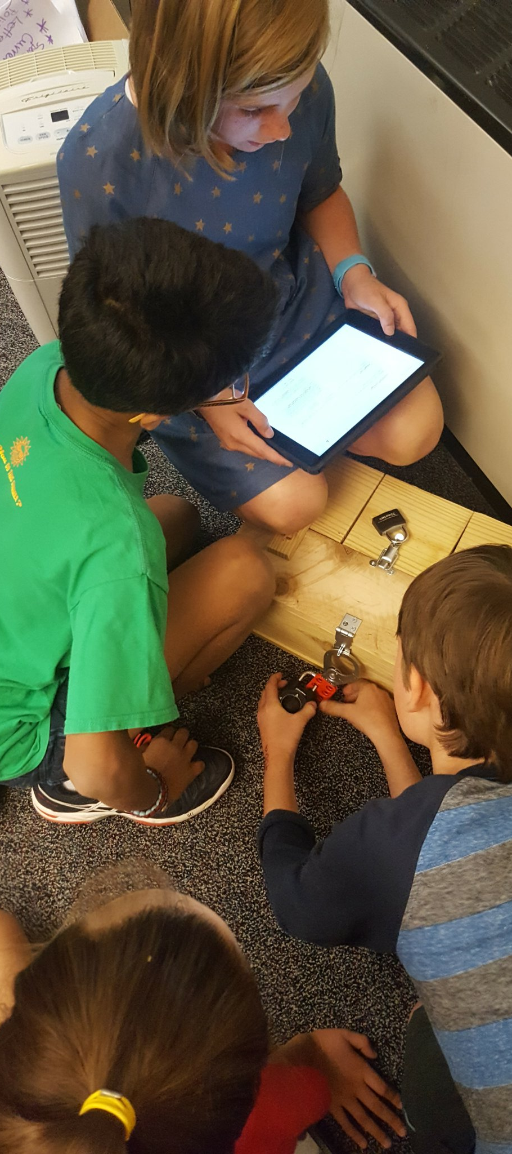
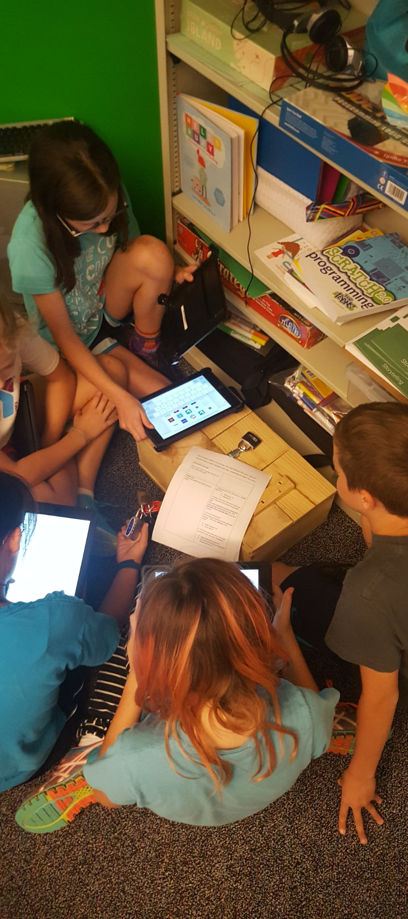

Slide 14
5 out of 6 C’s
Critical Thinking,
Creativity,
Character
Communication,
& Collaboration.
Culture?
Notes:
Education in the 21st Century (6 C’s)

Slide 15
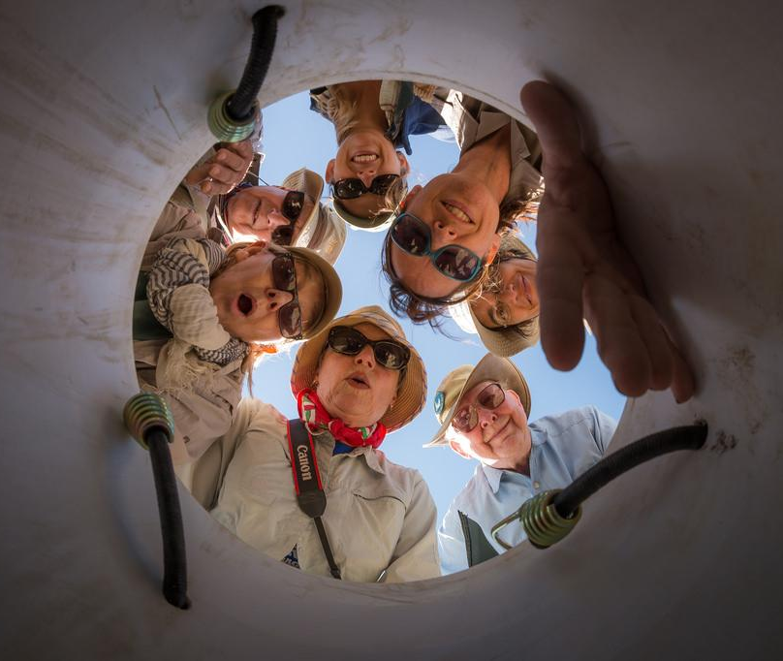
Avoiding Pitfalls
Plan, Plan, Plan
Don’t get locked-up (Directional Lock) or Timed-out
Don’t jump in and help
-Hint Cards
Prepare for noise, frustrations, and giggles!

Slide 16
Ideas for Implementation
Figure it out Friday
Team Building (admin plug)
Collaboration Cultivator
RTI Groups/ Book Clubs
Transform Makerspace area to Break-out
Notes:
Breakout EDU has gone Digital too

Slide 17
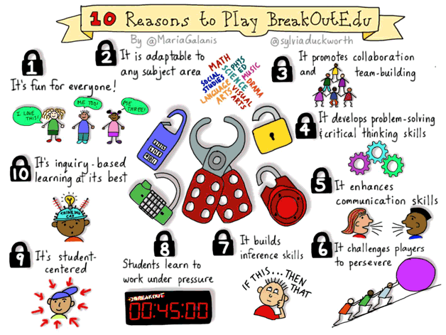
Notes:
Image by Sylvia Duckworth

Slide 19
In learning, the journey is
far more important than
the destination.
Notes:
Be sure to explain that there are two different options for obtaining a kit. People can purchase the kit from Breakout EDU or they can put one together themselves using the open source instructions. The only unique piece that we create is the wooden box. A regular tool box that you can lock also works.

Slide 20
Librarian Testimonials
Mighty Little Librarian: http://www.mightylittlelibrarian.com/?p=1357
School Library Journal http://www.slj.com/2016/09/reviews/tech/breakout-edu-brings-escape-room-strategy-to-the-classroom-slj-review/
True Adventures of a Highschool Librarian http://www.nikkidrobertson.com/2016/04/breakout-edu-jchs-library.html

Slide 21
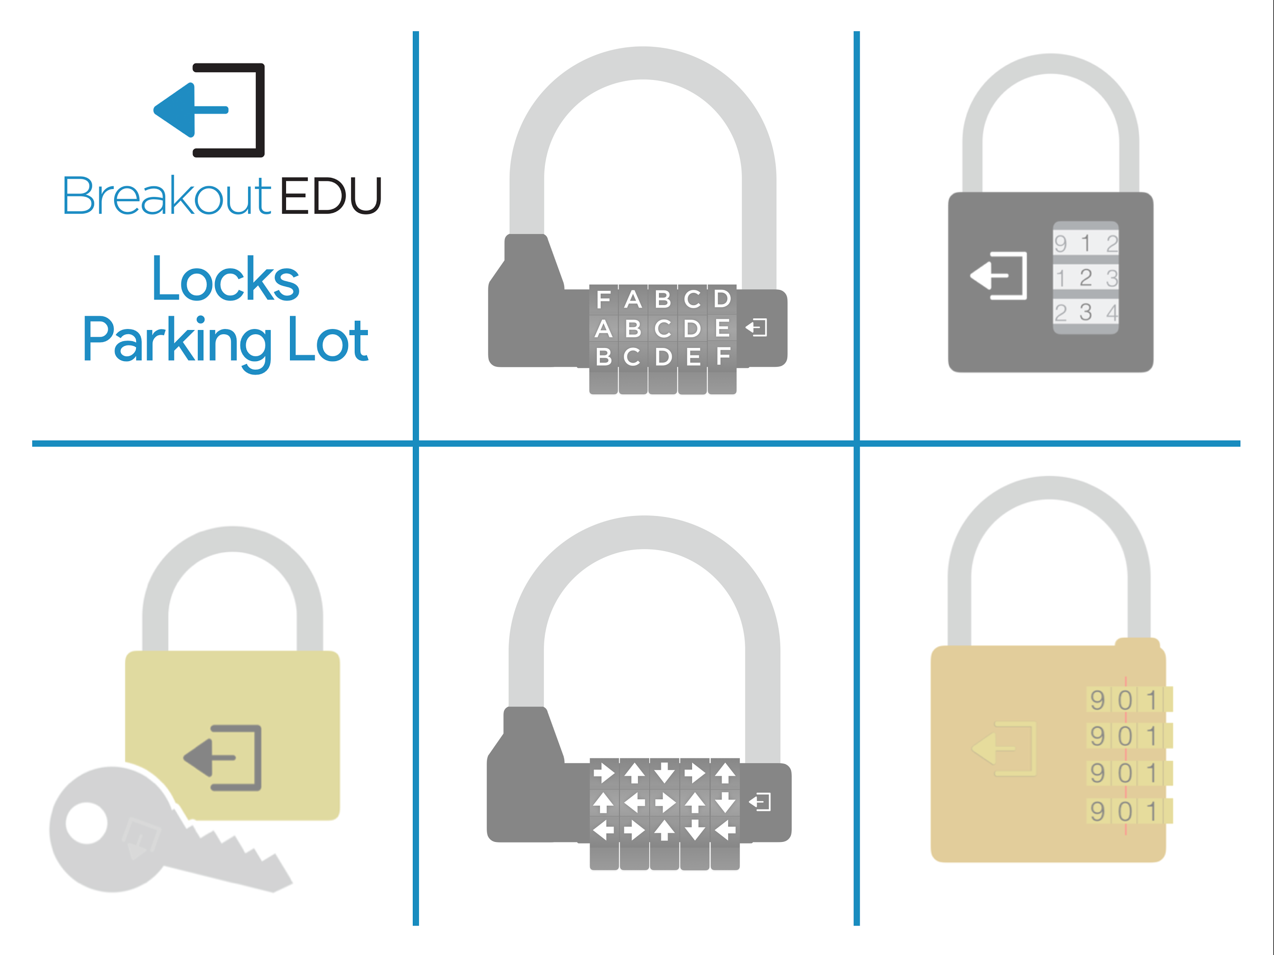
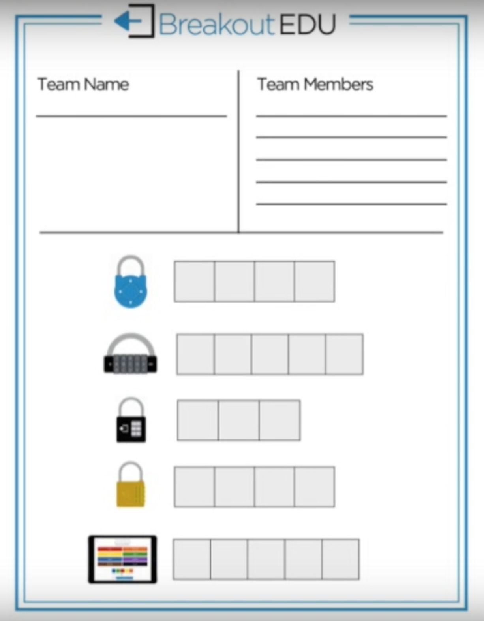

Slide 22
Sources
http://www.jigsawplanet.com/
http://morsecode.scphillips.com/translator.html
http://www.qr-code-generator.com/
http://www.breakoutedu.com/gra
http://www.contxts.com

