Slide 1
Campfire Session 7-12-12
Elementary Edition:)

Slide 2
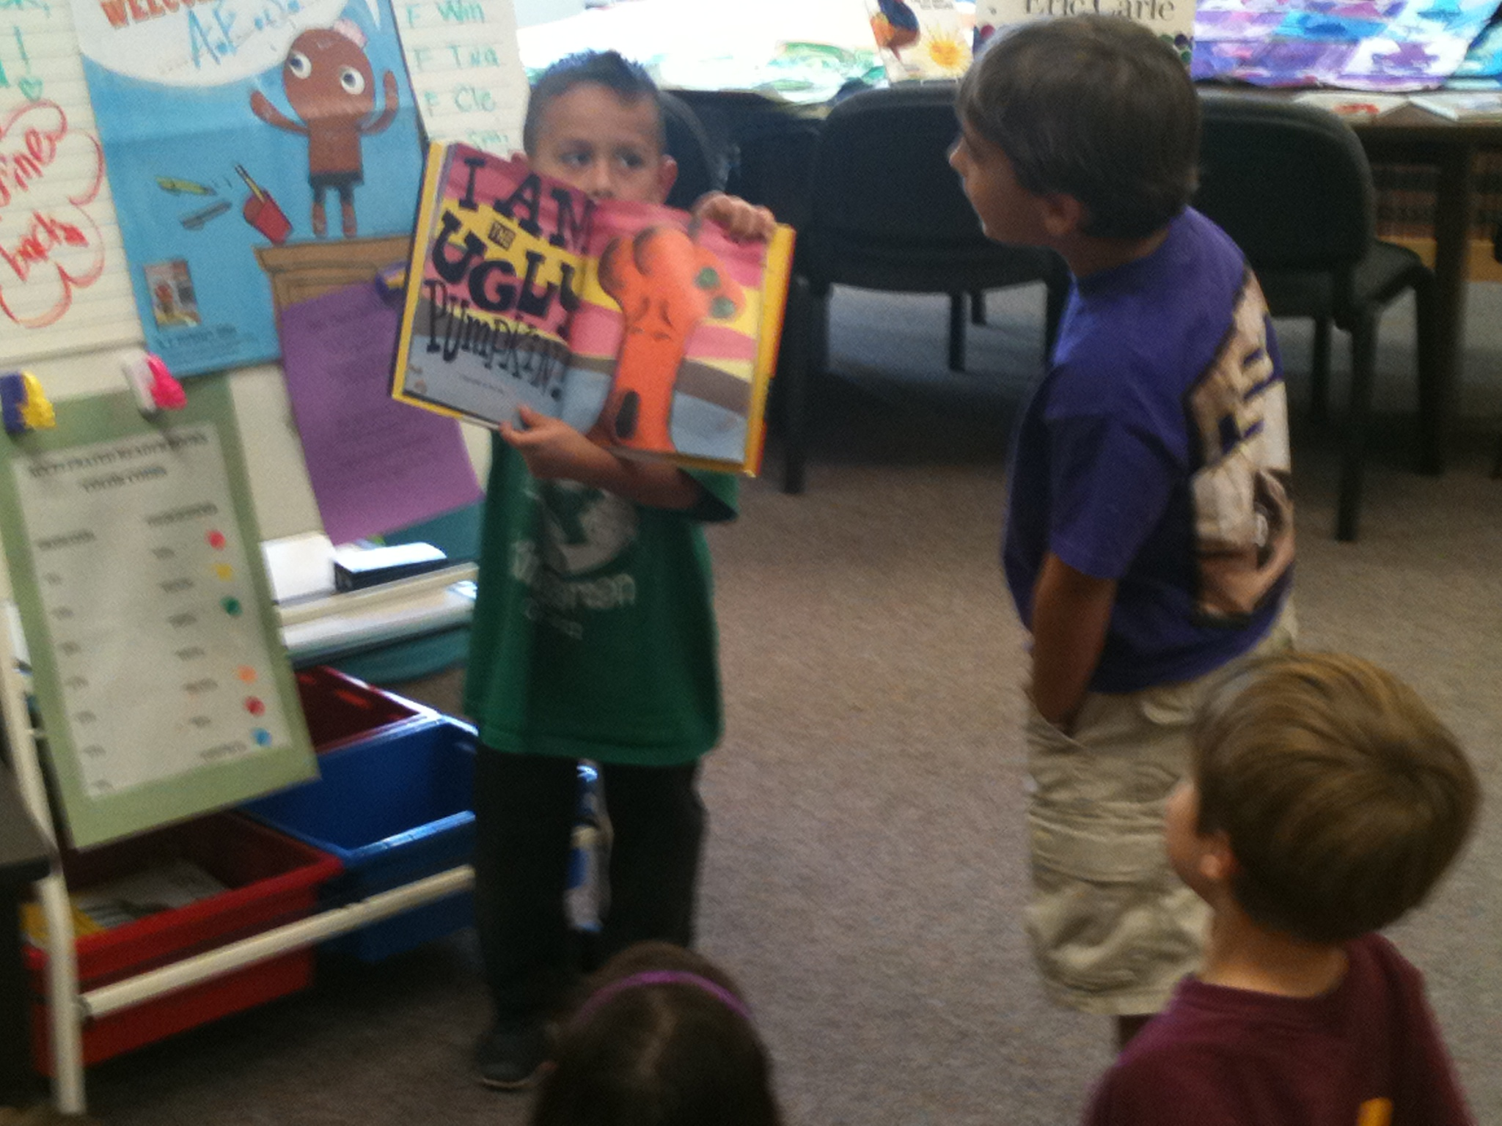
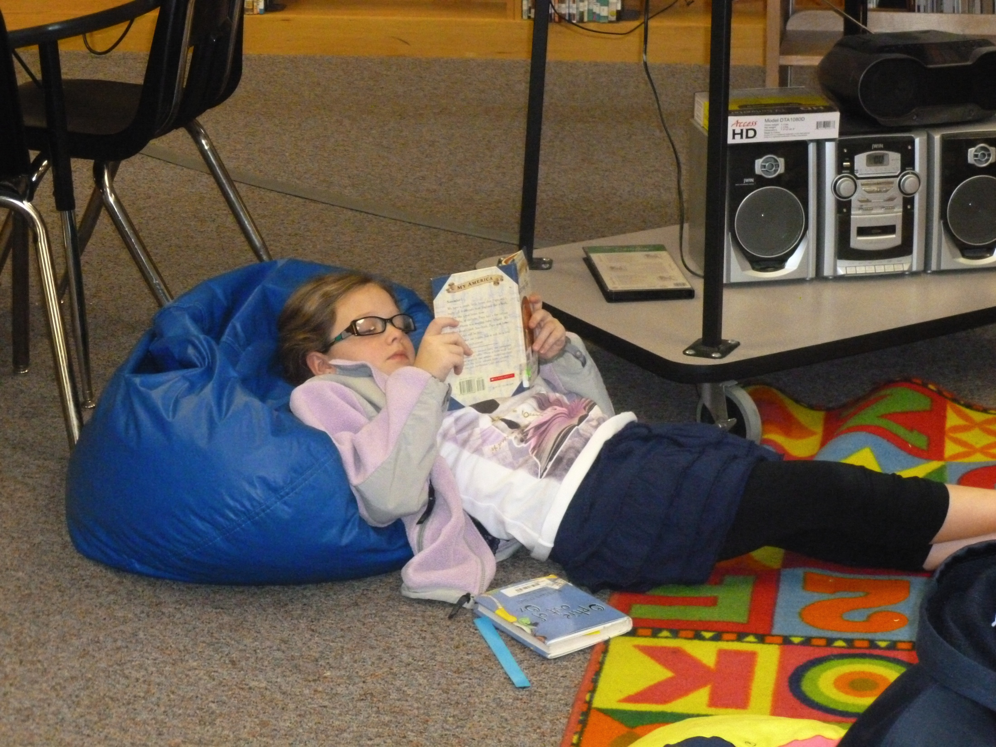
Management Book…classroom…inventory…etc

Slide 3
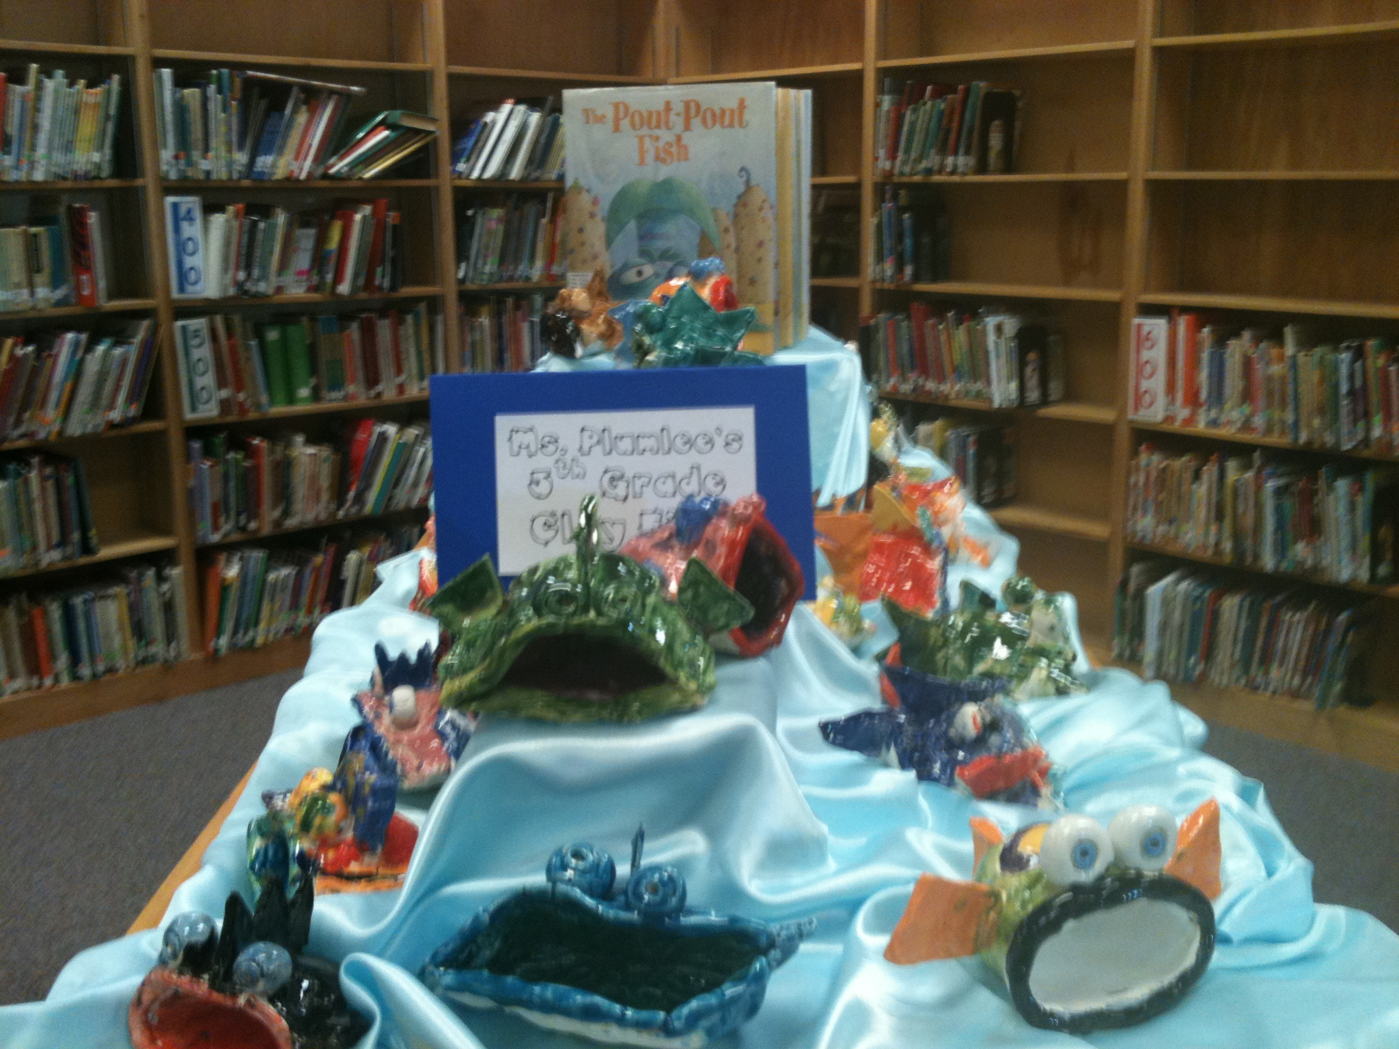
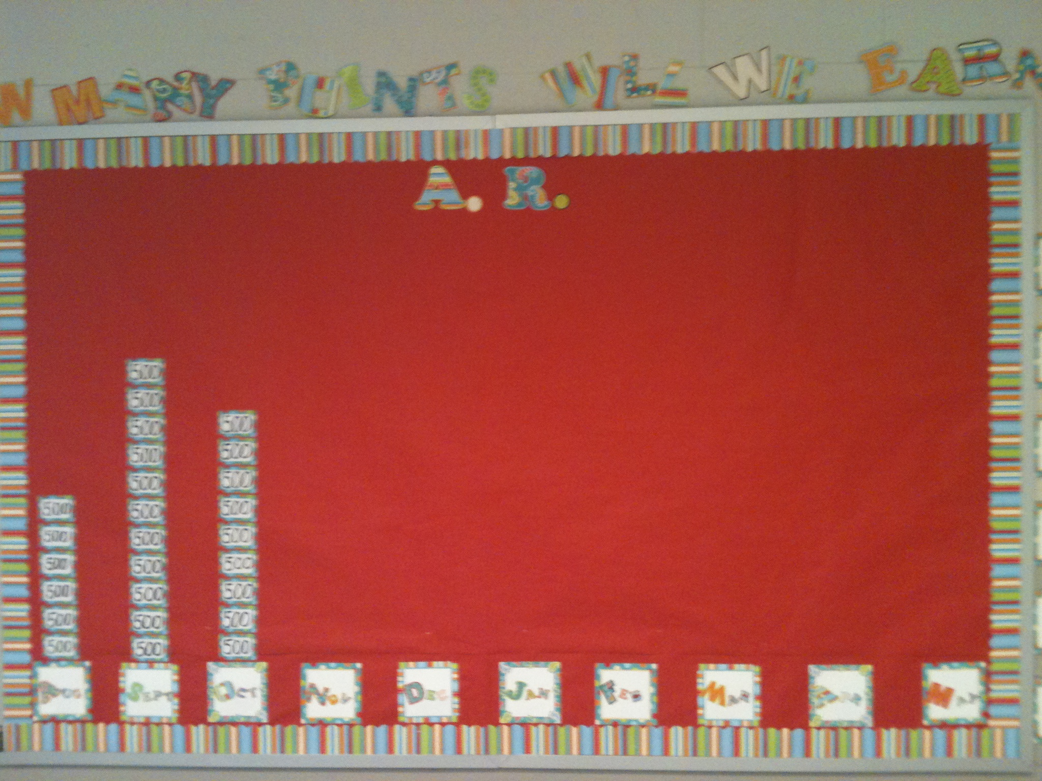
Book Promotions/Displays

Slide 4
Lessons
Favorite books 1st week of school…..
The Gingerbread Man Loose in the School by Laura Murray
Miss Smith’s Incredible Storybook series by Micheal Garland
Alphabet Mystery/Rescue/Adventure by Audrey Wood
LOVE to use
Holiday books, Themed books, etc……..

Slide 5
Websites/Technology
Pinterest – NeW LoVE (even for library lessons:)
Wegivebooks.org – NEXT favorite!!
Watchknowlearn.org - common core standards, free educational videos- organized!! This is AWESOME too!!
Wordles – soo fun!!! Use academic vocabulary or themes
Zamzar to download youtube videos to show at school
Informationliteracy.org

Slide 6
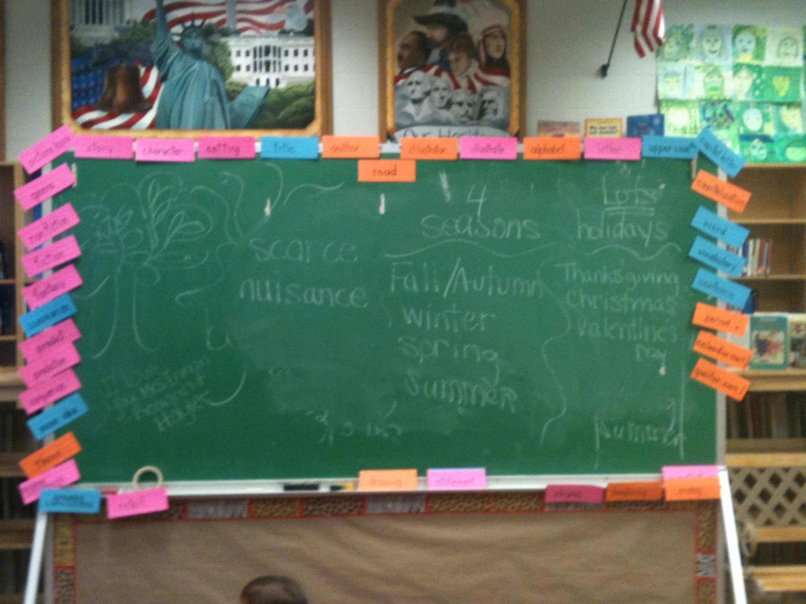
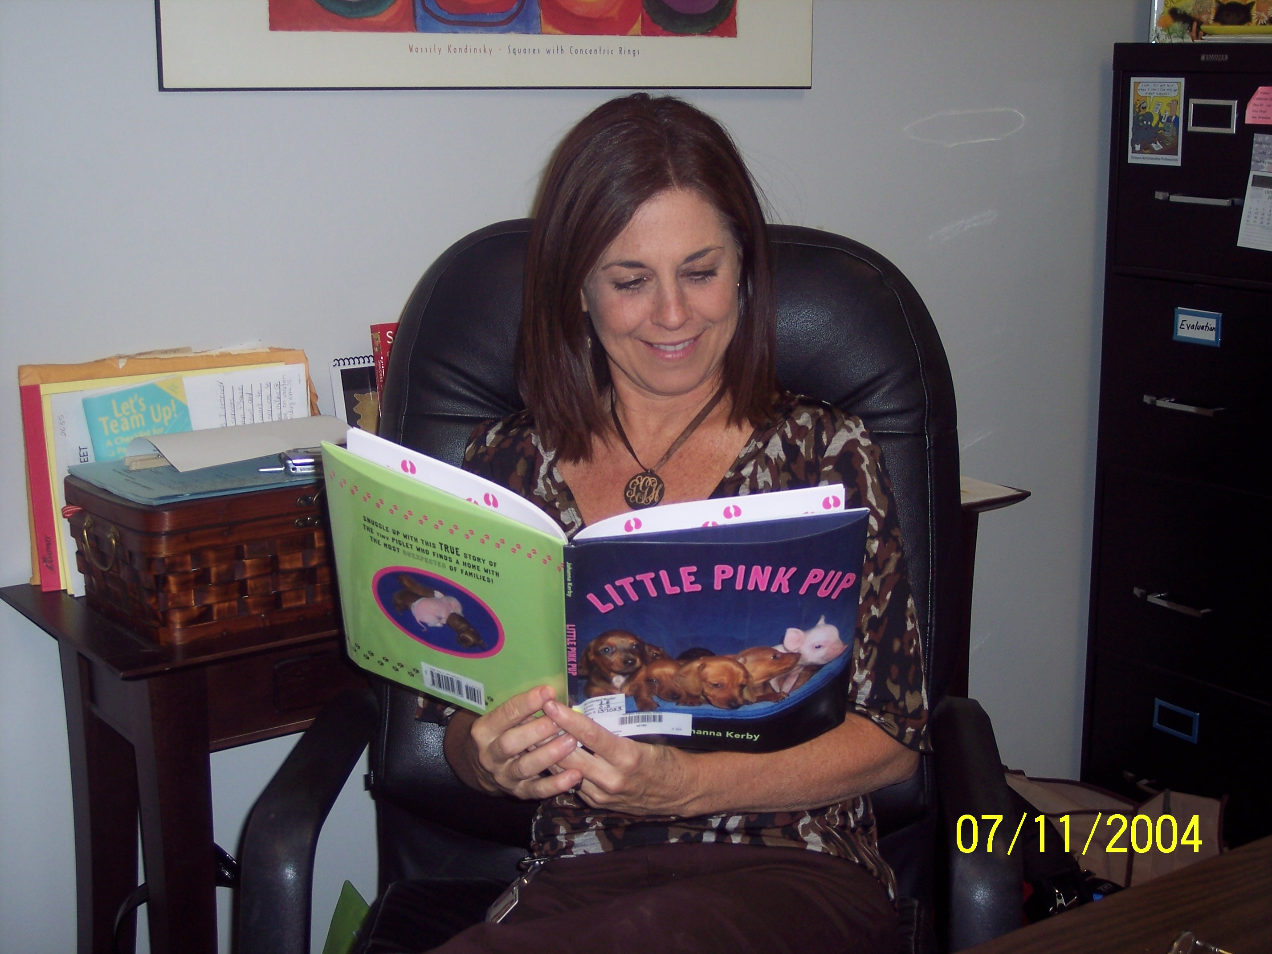
Collaboration with teachers/ARTS
Academic Vocabulary – posted in library
Tell teachers/email teachers what we are doing in library weekly/monthly
Stuart Murphy math concept series
Science concepts / folktale/fairy tales/myths/legends-get lesson plans- some too late, at least know!!!
Teacher request file – email when come in – marriage of Q&U
Teacher survey – topics need more of in library(used
In professional notebook too!)
**Teacher/administator book highlight on bulletin board outside library:)

Slide 7
Evaluation Tips/Ideas???
Use wheel of Bloom’s Taxonomy – see pdfs
******Master Instructional Strategies flipchart*****
Always include some connection to classroom lessons/skills they are doing NOW
Common Core implementation??? “There’s an app for that”
Formative assessments – SCS exemplary teachers -

Slide 8
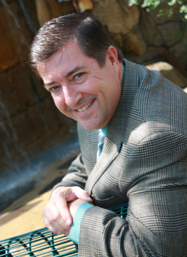
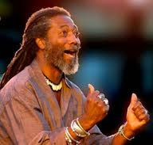
Author visits:) who?? what??
Michael Shoulders – LOVE!!! V is for Volunteer
Mike Thaler –Black Lagoon???
Toni Buzzeo – prof books, too!
Christopher Canyon – illustrator:)
Len Cabral – storyteller !!
Ronda Friend :)

